Slide 1
Southland’s
Environmental Cultural History

Slide 2
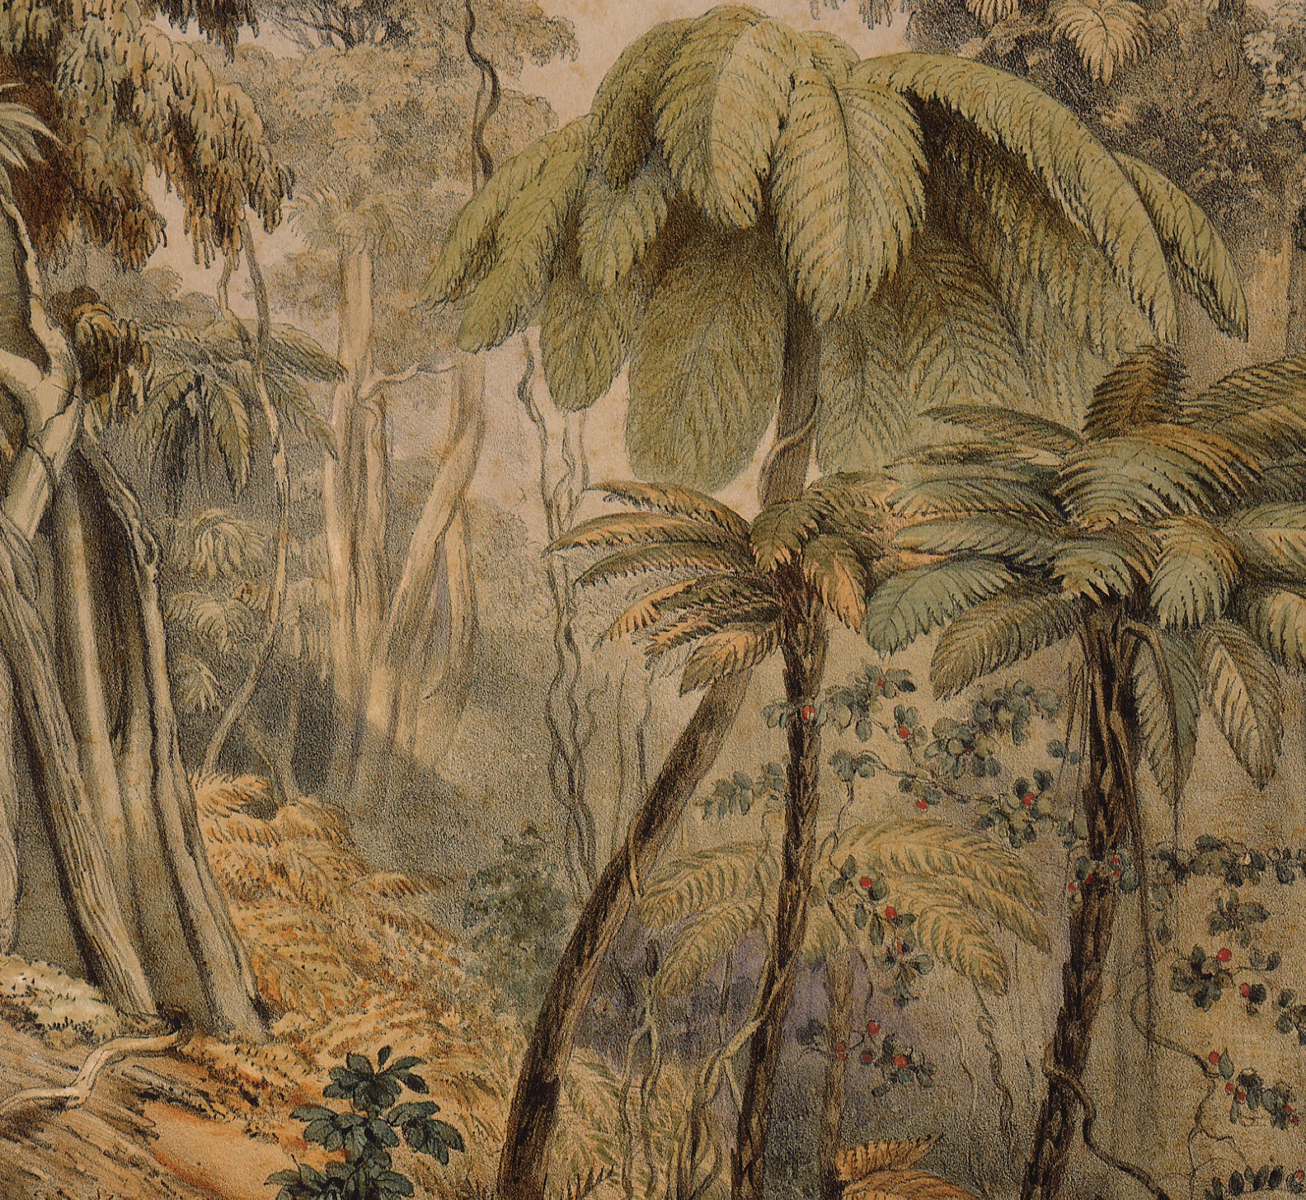
In the beginning
Traces of human occupation in Murihiku (the tail end of the land - Southland) can be dated back to 1300.
Prior to human settlement the environment, species and vegetation were quite different.
Historians estimate approximately 85 percent of Southland was covered in forest.

Slide 3
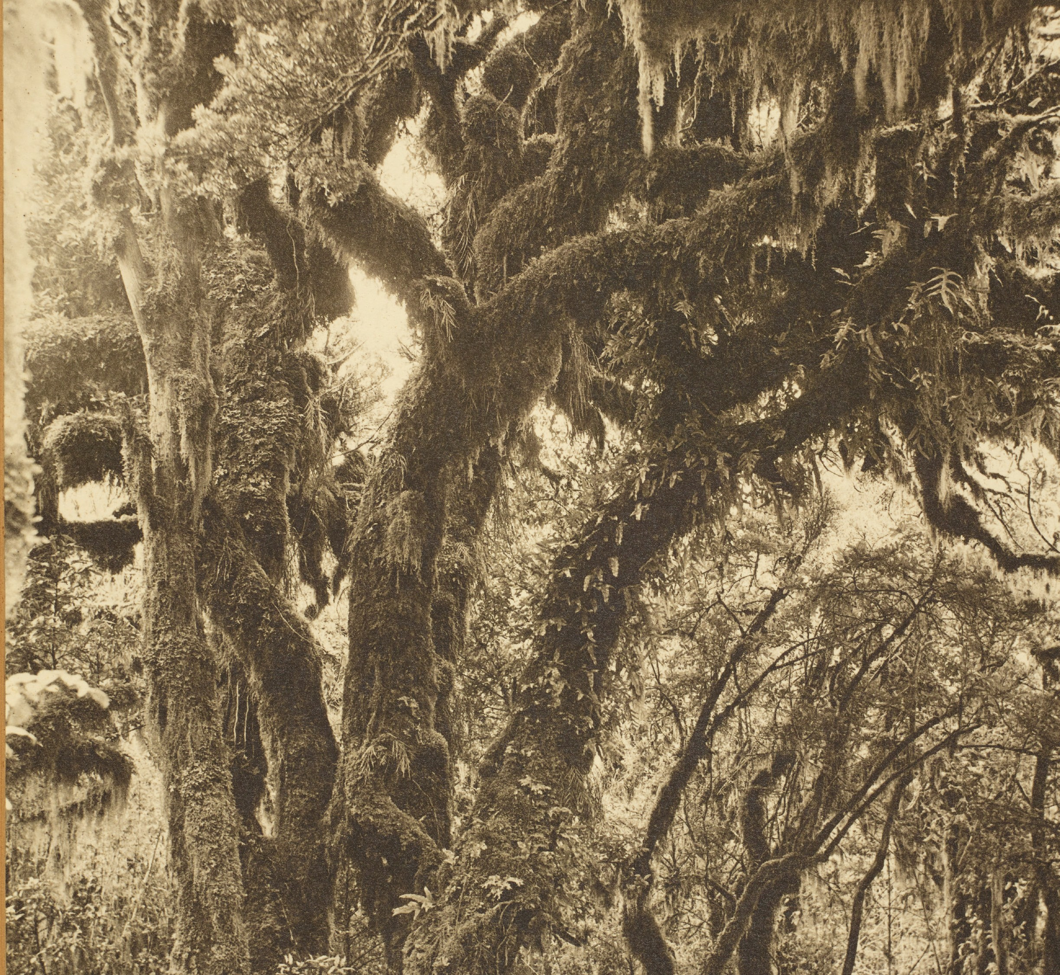
Vegetation
Kowhai-ribbonwood forest – along river margins.
Totara forest – in the Otatara/Sandy Point-Oreti Beach area.
Silver beech forest – along Mataura River.
Mixed broadleaf (podocarp) and rata-kamahi forest – on the limestone hills. Lowland forest, mainly matai, kahikatea and mixed podocarp – Southland Plains. Upland areas were dominated by beech forest.
There were relatively few areas of tussock and shrubland. Nine percent of the region was wetland.
Southland’s Waitutu Forest - the largest area of unmodified lowland forest left in New Zealand with a mix of podocarp, hardwood, beech, has been described by botanist and environmental campaigner David Bellamy as ‘probably the most important forest in the world.’

Slide 4
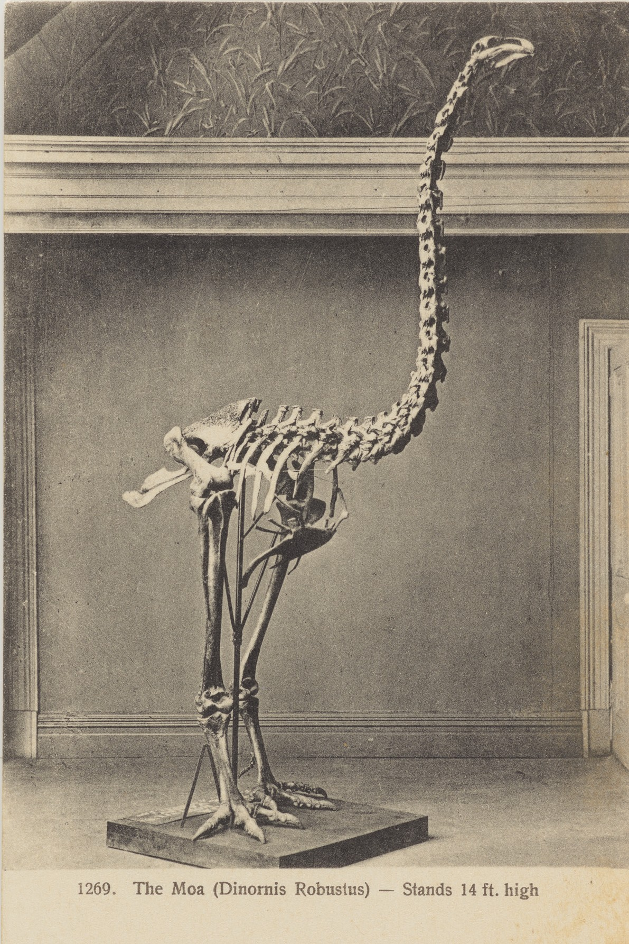
Living relics
Waitutu Forest is the largest area of unmodified lowland forest (podocarp, beech, hardwood) in New Zealand and is home to the South Island’s largest kākā population.
Without fear of predators, native birds and other wildlife roamed freely in the vegetation. Among them were the legendary moa and its only predator, the Haast’s eagle. Both are now extinct.
FIG 1. collections.tepapa.govt.nz | MA_I419329_TePapa_The-Moa-Dinornis-Robustus

Slide 5
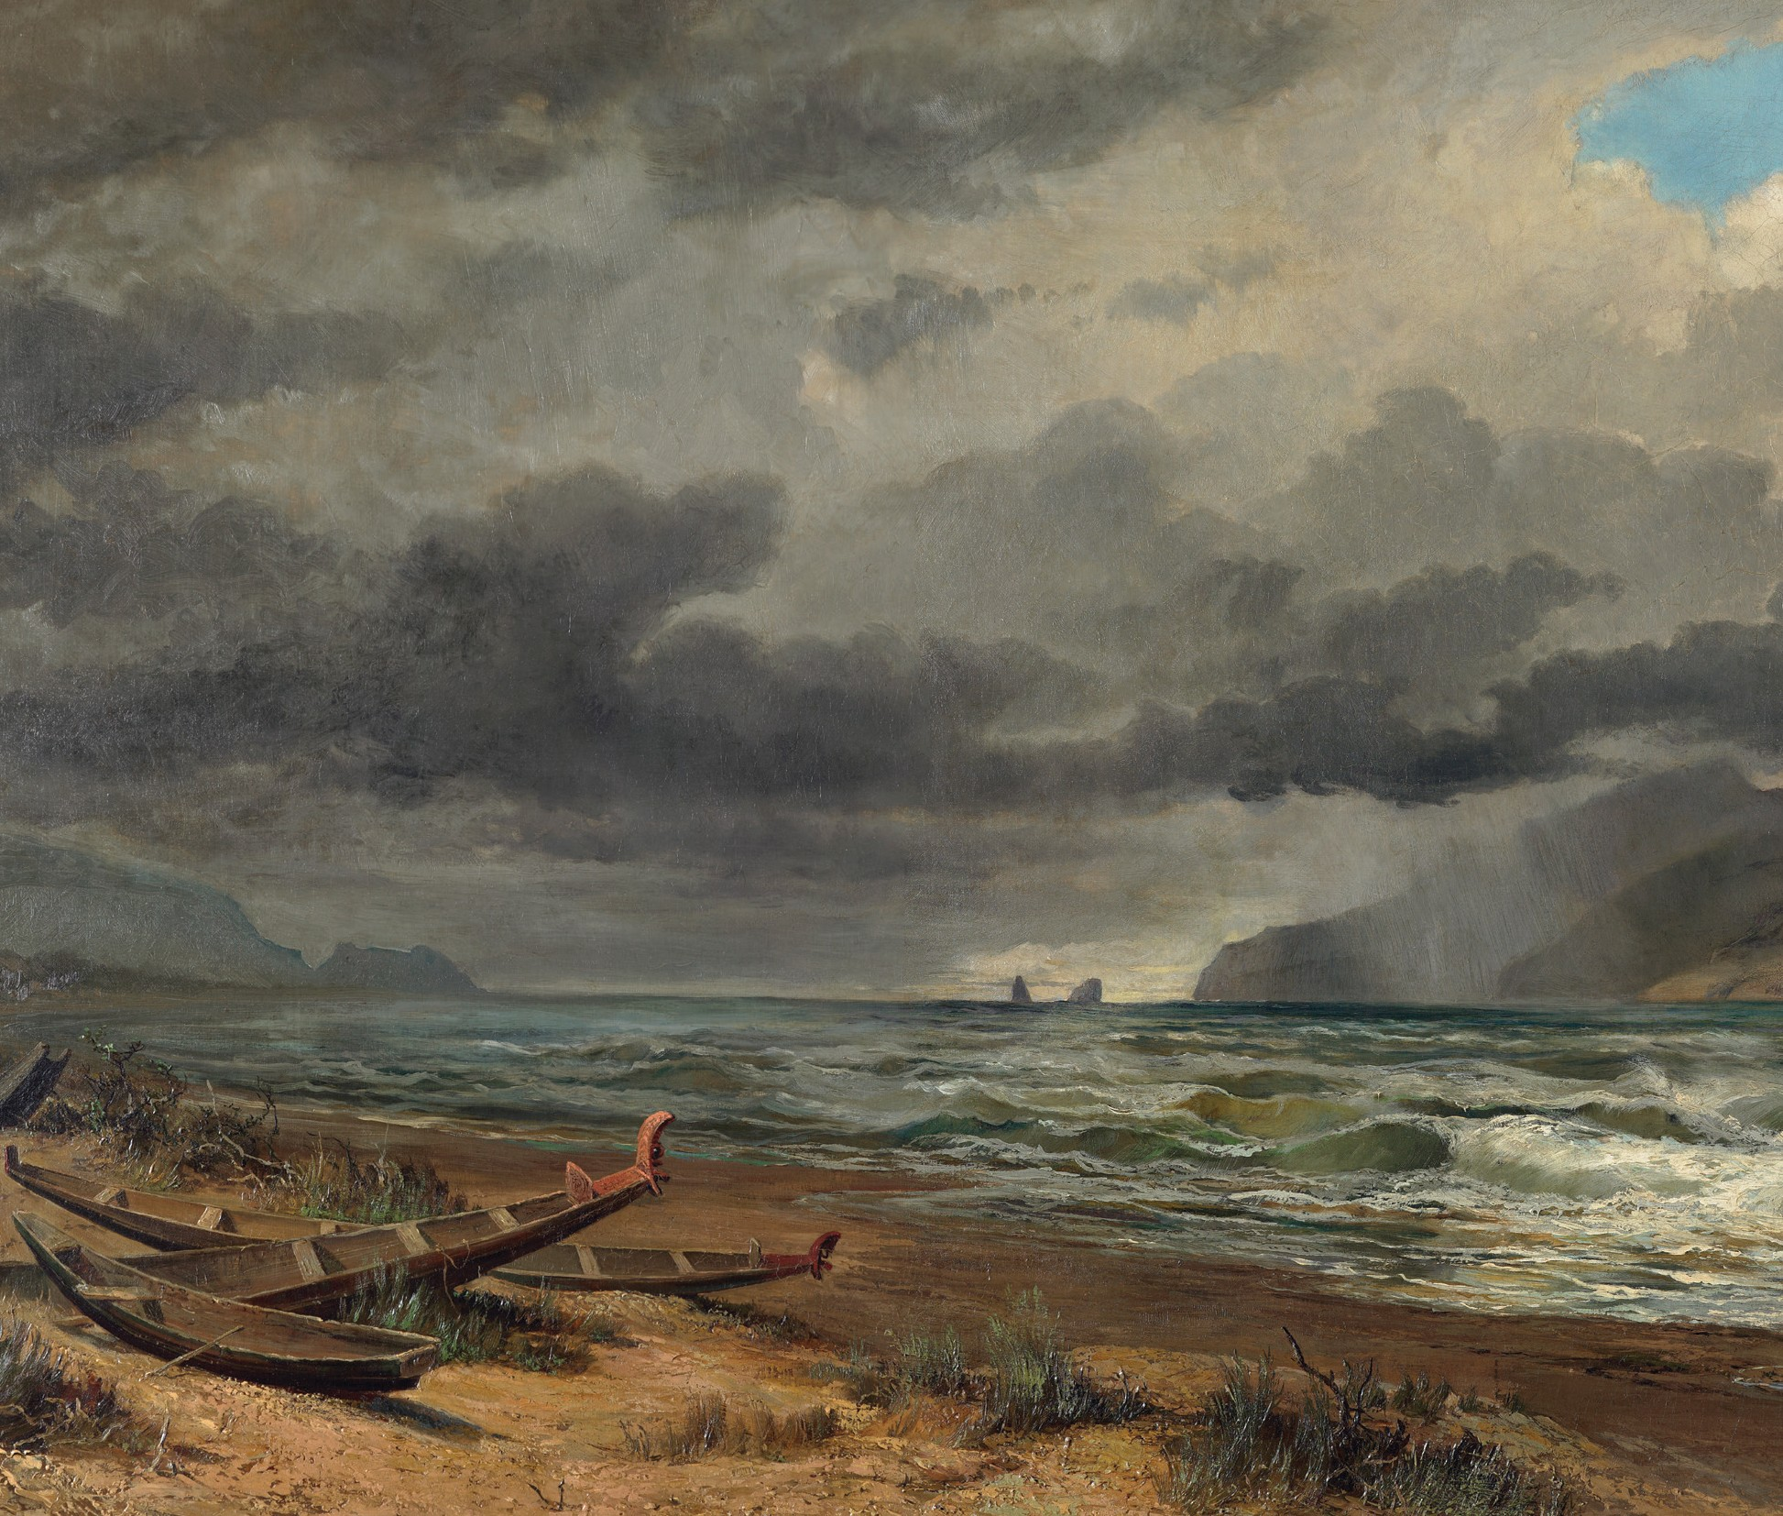
Arrival of humans
For all Māori, history begins when the first settlers of Polynesia colonised Tonga from the west - about 1500 BC.
Over the next 2,000 years their descendants colonised the remainder of Polynesia, starting with Samoa, then moving on to the Marquesas (about 2,000 years ago), Tahiti (1,500 years ago) then on to Easter Island, Hawaii, New Zealand and the Chathams.
They found New Zealand uninhabited, but full of wonderful new food sources. Some of the features typical of this period were moa hunting and sea-mammal hunting, supplemented by crops of root vegetables.
FIG 2. collections.tepapa.govt.nz | MA_I127510_TePapa_Cook-Strait-New-Zealand

Slide 6
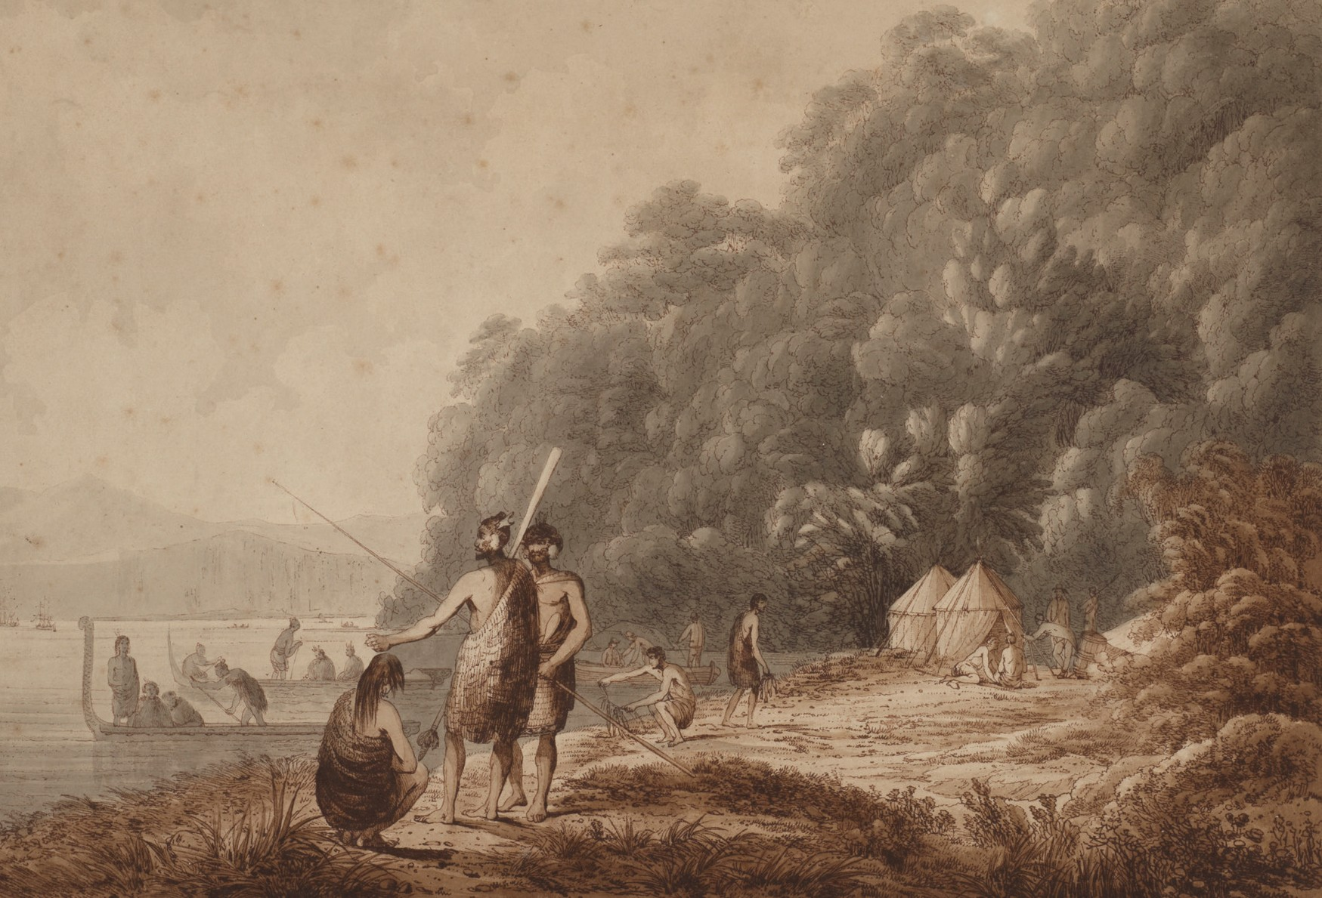
Māori settlement
FIG 3. collections.tepapa.govt.nz | MA_I127510_TePapa_Cook-Strait-New-Zealand
Ngāi Tahu’s migration to Te Wai Pounamu (the South Island) occurred in three waves.
» The iwi Waitaha’s waka, Uruao, landed in Nelson. As they explored south, Waitaha bestowed names on geographical areas.
» Kāti Māmoe were drawn south from the East Coast of the North Island by the plentiful resources, merging with Waitaha.
» Descendants of Tahu Pōtiki followed the route down to Te Wai Pounamu. Through inter-marriage, warfare and political alliances, Ngāi Tahu (the people of Tahu) emerged as the manawhenua (people of the land) of Te Wai Pounamu.
Living off the land and continuing mahinga kai (food gathering) traditions have always been important to Ngāi Tahu. They survived by gathering from the forests, plains, lakes, rivers, seas and the surrounding islands.
The climate of Te Wai Pounamu drove the development of ingenious ways to preserve, store, transport and trade resources.
1100s-1700s
The arrival of permanent settlements of Māori and the establishment of Ngāi Tahu in Southland meant land began to be occupied from coastal to inland areas, and was defined by a hunter-gatherer lifestyle.
Early iwi in Murihiku had to learn to adapt to new resources. Knowledge was gathered on how to utilise local trees, plants, birds and fish for kai (food), rongoā (medicine), clothing, whare (buildings), waka and mōkihi (rafts).
Rivers were utilised not only as sources of mahinga kai, but also as highways and trade routes; a way to bring resources out from the interiors to coastal settlements.

Slide 7
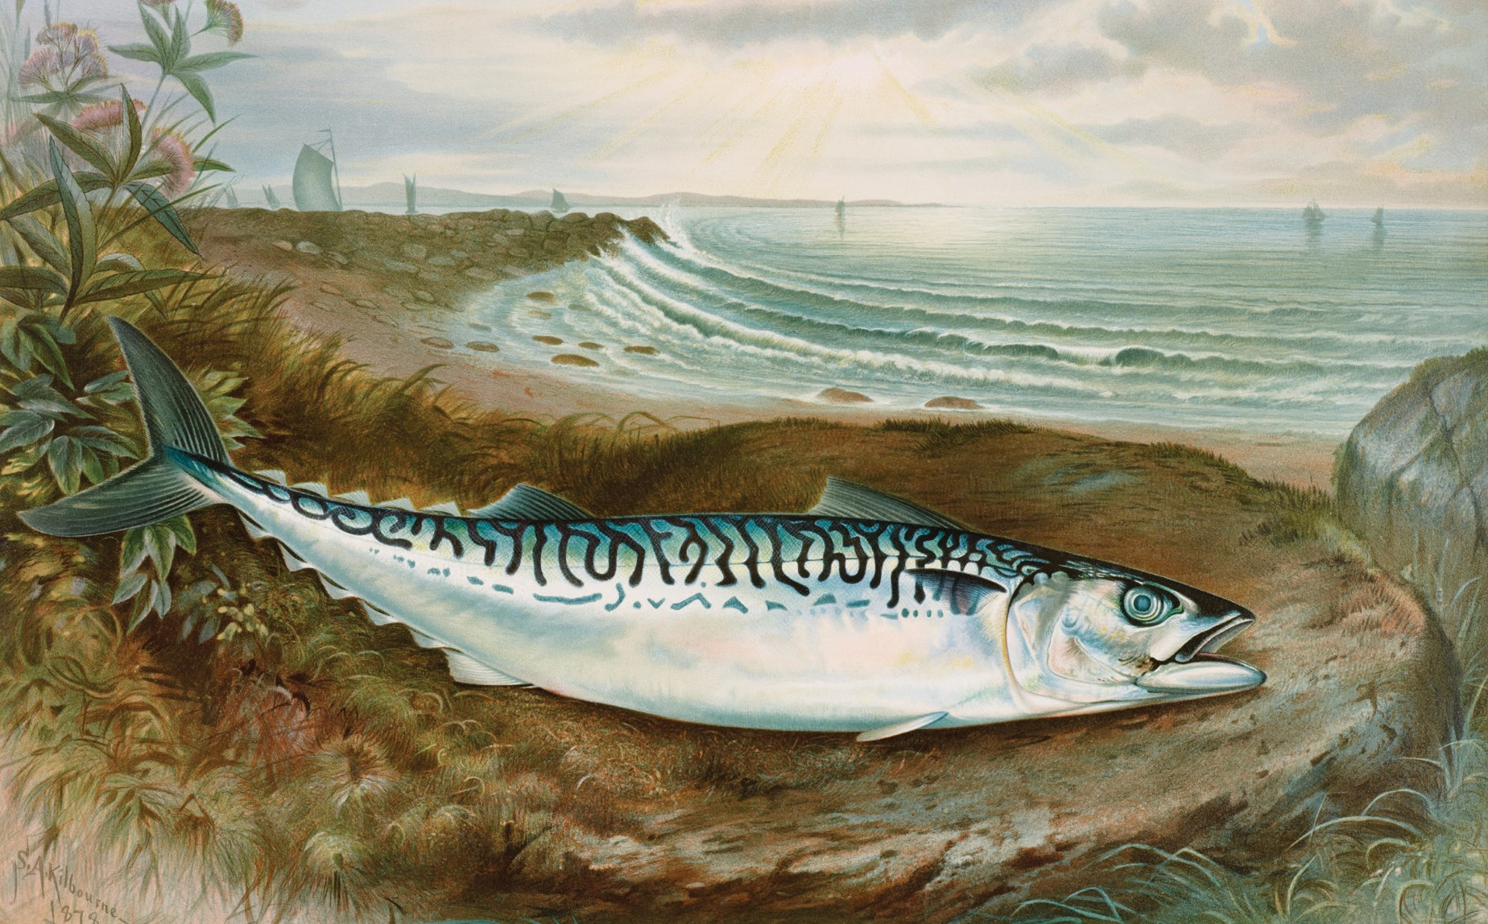
Hunter-gatherer lifestyle
Use of fire as a deliberate tool to
» Hunt moa (forced extinction).
» Encourage the growth of bracken fern (a key food source).
» Clear tracts of land for easier access and travel.
Seals
» Favoured for their meat, seals’ fur made warm clothing and their teeth were used for fish hooks.
» Seals were so easy to find on rocky shores that most colonies disappeared.
Birds and fish
» The sea provided food all year.
» Groups of Māori would move inland from late winter into summer to fish from rivers.
» In autumn kākā, kākāpō, kererū, takahē and weka were hunted.
FIG 4. Mackerel fish chromolithograph (1878) by Samuel Kilbourne. Original from Museum of New Zealand. Digitally enhanced by rawpixel.

Slide 8
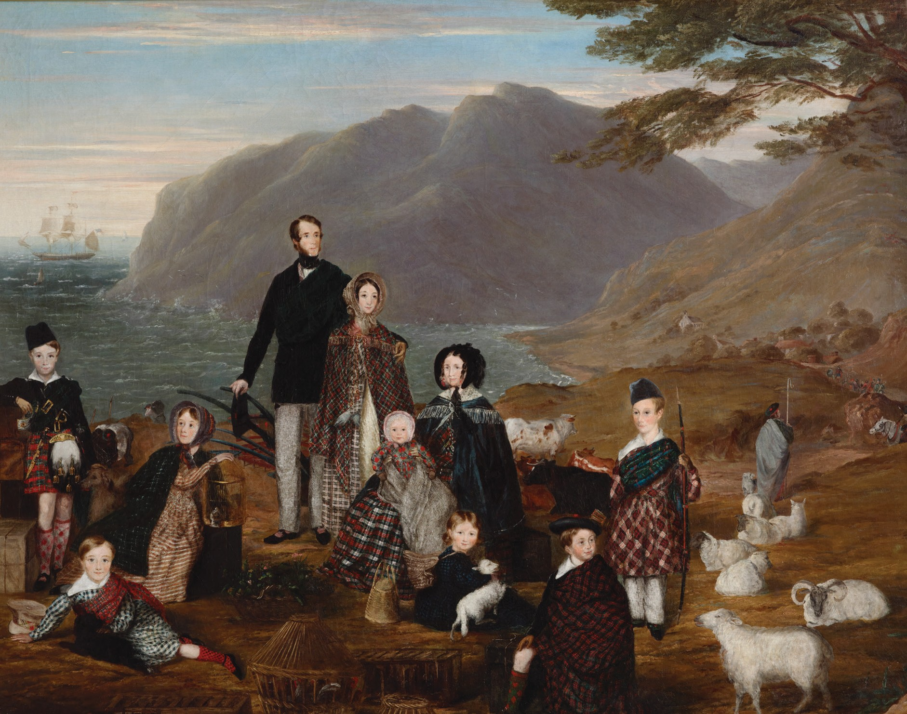
The Europeans arrived
Europeans slowly trickled into Southland, drawn here by the natural resources and land which could be converted into profit. This led to changes in land use and the environment.
European settlement timeline
Late 1700s Sealers
Early 1800s Flax harvesters 1800s – 1900s
1900- 1950
1951 - 2000
> 2000
This timeline will help highlight how different periods of land use have impacted the environment, with emphasis on freshwater management units (the main river systems, such as Aparima for example).
FIG 5. The emigrants, 1844, London, by William Allsworth. Purchased 1992 with New Zealand Lottery Grants Board funds. Te Papa (1992-0022-1)

Slide 9
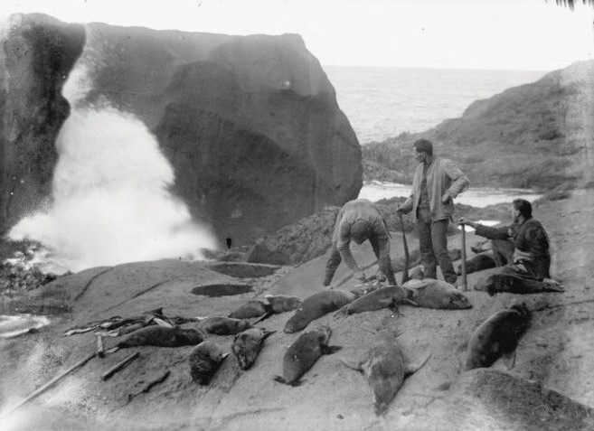
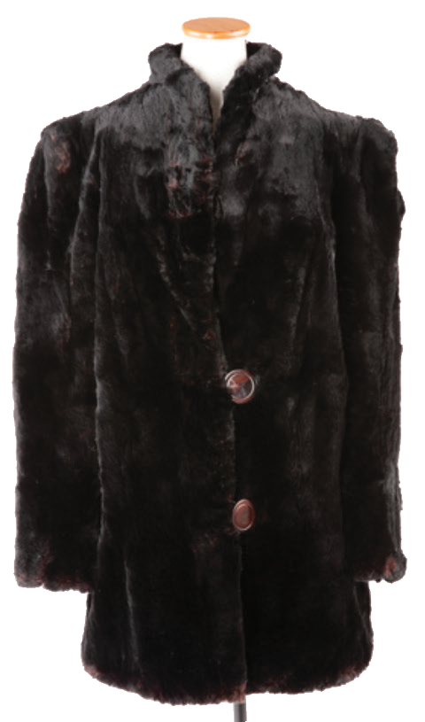
Sealers - late 1700s
In 1773 Captain James Cook anchored at Dusky Sound in Fiordland where his crew killed seals. News of the quantity and quality of seals soon brought sealers in from Australia.
In 1792 the Britannia left Dusky Sound with 4,500 skins for the Chinese market. Seal skin was highly sought after in Britain, China and America for clothing and accessories.
Sealing gangs were left in remote areas and islands around coastal Southland where early contact was made with iwi.
1802–1810 saw the greatest activity, with thousands of seals indiscriminately slaughtered, endangering the population. By 1810 sealing was no longer profitable. There were revivals in the 1820-30s, but after that any sealing was to supplement other trades.
Concerned by the decreasing seal population, the New Zealand Government confined hunting to the winter season by law in 1875. By September 1946 sealing officially became illegal.
FIG 6. natlib.govt.nz | Sealers, c.1914/1915
FIG 7. ehive.com/collections/3278/objects/938773/coat-fur-seal

Slide 10
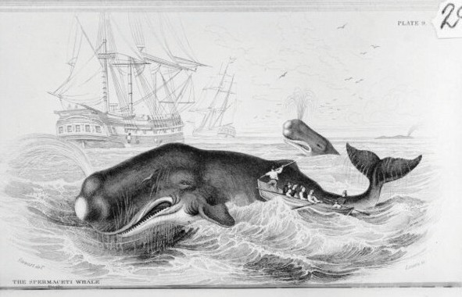
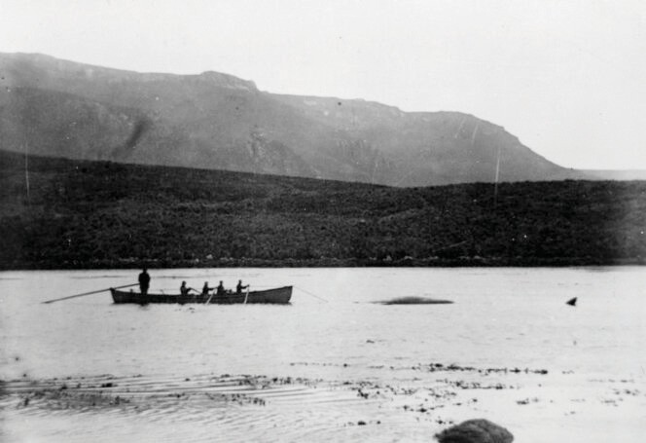
Harakeke - flax
FIG 8. natlib.govt.nz | Illustration of NZ Whalers
In the 1820s, the harakeke trade emerged alongside sealing and whaling.
Māori demonstrated their skill in dressing flax (stripping the fibre from the leaves). They made flax ropes for visiting ships, and bartered flax and weaving for European goods. This trade brought Māori and Europeans into further close contact with each other.
The first harakeke export occurred in 1823 and continued in sizeable quantities. In 1831 the Samuel
landed in Australia with 500 seal skins and 10 tonnes of flax.
In 1829 New Zealand’s first whaling station opened at Rakituma (Preservation Inlet) producing 120 tonnes of whale oil that year. Rising whale oil prices, driven by the industrial revolution, saw whaling stations established in Omaui, Oue, Bluff and Jacobs River.
The boom was short-lived as demand for whale oil dropped. Preservation Inlet closed in 1836 with most others closing in the 1850s.
Harakeke demand continued following the transfer of skills from iwi to Europeans.
Between 1880s-1970s more than 160 flax mills functioned in Southland. Harakeke peaked in value during World War 1 and dropped post World War 2 with the removal of subsidies. The fibre was used for ropes, sacks, twine and packing furniture.
FIG 9. natlib.govt.nz | Whalers in Perseverance Habour, 1916

Slide 11
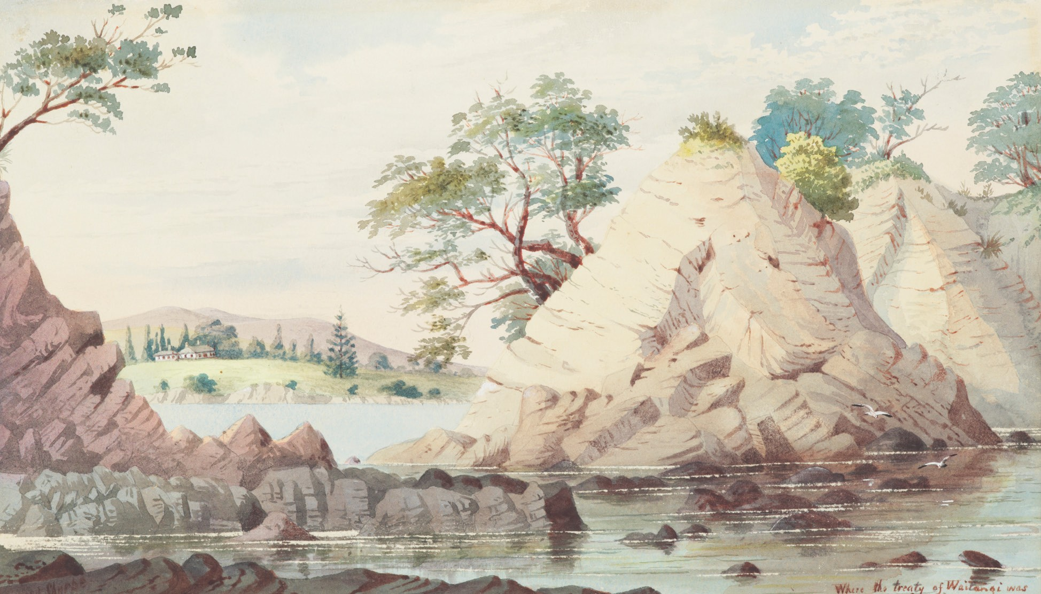
Ngāi Tahu - early 1800s
Ngāi Tahu had their first contact with Pākehā sealers and whalers from around 1795. By the 1830s Ngāi Tahu had built up a thriving industry supplying whaling ships with provisions such as pigs, potatoes and wheat. Shore stations were established from 1835 under the authority of local Ngāi
Tahu chiefs.
Many Ngāi Tahu women married whalers, and the tribe was no stranger to European ways. When seven high-ranking southern chiefs signed the Treaty of Waitangi in 1840, it was a convenient arrangement between equals.
Between 1844 and 1864, in a series of 10 land purchases, most of Te Wai Pounamu was purchased by the Crown from Ngāi Tahu.
The Crown failed to honour its obligations under these land purchase agreements. Over the ensuing years the tribal authority was diminished, people were ostracised from their land, connections were fragmented, language and knowledge suppressed.
FIG 10. collections.tepapa.govt.nz | MA_I156238_TePapa_Where-the-Treaty-of-Waitangi

Slide 12
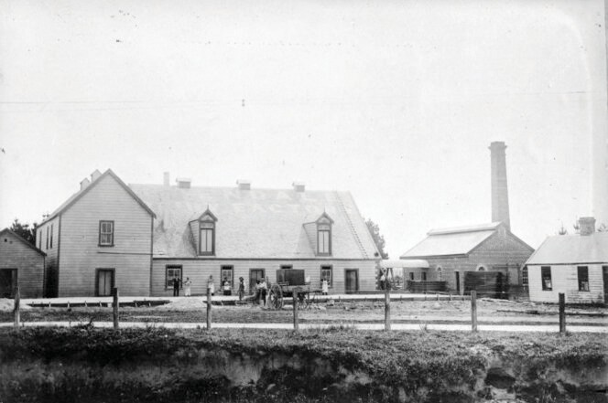
Agriculture post Treaty 1853-1900s
Following the 1853 Murihuki purchase, European settlers began moving south and clearing land for agriculture, converting about 43 percent of mainland Southland with a dramatic loss of native vegetation resulting.
1. Agriculture and pastoralism
Wool and grain dominated post-Treaty farming.
The first sheep arrived in 1854, grazing on sown pasture rather than natural grasslands. Wool was the main export.
In 1876 Thomas Fleming began purchasing the 13 established Southland mills to create the Flemings brand. Milling reached its peak in the 1880s as refrigeration drove a change in focus to meat export.
2. Mining
Gold was mined at Waikaka in 1867 and Round Hill in 1874.
Rich seams of coal were discovered in the 1870s. Nightcaps Coal Company began operating in 1880, extracting 1.8 million tonnes until closing in 1923. Production then began in Ohai.
FIG 11. natlib.govt.nz | Edendale Dairy Factory, 1895

Slide 13
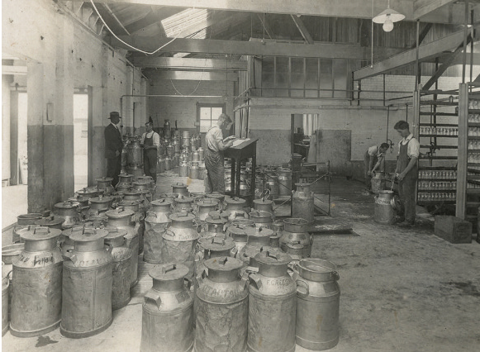
Dairy
By 1871 Southland dairy factories were producing 70 tonnes of butter and 32 tonnes of cheese. At peak, the province had 88 dairy factories, with Edendale opening in 1882.
The refrigeration era – 1882
Refrigeration saw the market for sheep products expand from just wool.
Southland Frozen Meat & Produce Company, formed in 1881, shipped 6,550 carcasses from Bluff to London in 1883.
Freezing works to provide cargo for ships followed in Bluff, Makarewa and Mataura.
Refrigeration locked New Zealand into producing three staples (meat, dairy and wool) for one market – Great Britain. In 1905 Britain purchased 91 percent of our exports.
FIG 12. natlib.govt.nz | Men tipping cream, Edendale Dairy Factory

Slide 14
1900-1950
Impact on Ngāi Tahu 1800-1900
In the case of Ngāi Tahu, 99.9 percent of tribal territory was in Crown possession by 1863 – only 23 years after the signing of the Treaty of Waitangi.
The Crown’s actions left Ngāi Tahu with insufficient land to maintain the tribe’s way of life due to the restricted ability to fully participate in economic development.
As a result, many Ngāi Tahu became impoverished and virtually landless.
This state of poverty and lack of healthcare exacerbated the effects of European diseases.
By 1940, Southland was becoming one of New Zealand’s most prosperous and intensive pastoral regions with a strong specialisation in the production of lamb for the British market.
This was a period when Southland agricultural systems continued to be based on English farming methods.
Such farming consisted of crop rotation, selective breeding, transition to new manufacturing processes and a more productive use of arable land.
The application of ‘high farming’ principles (using the most efficient methods) and the continual rise in prices led to vast increases in the value and volume of exports.
During this period, Southland farming entered a stage of agricultural maturity and specialisation. The switch from traditional British methods of farming to a system of intensive grassland farming led to further increases in productivity.

Slide 15
Environmental impact: 1951-2000
Agriculture 1951–2000
In the latter part of the 20th century, as a producer of primary products Southland became increasingly integrated into the world economic system.
In the latter part of the 20th century, expansion into undeveloped land ceased. The way in which agricultural land was being used in Southland changed.
Farming different animals and crops, along with increased productivity and yields continued to place the environment under strain.
Loss of wetlands
Since 1990, there has been a 23 percent decline in wetland area in Southland, approx 7395ha have been lost (no longer present) or are considered at risk.
Wetland areas were drained and replaced with high-producing grassland to support agricultural production increase.
Water Pollution
According to Environment Southland, the following are responsible for polluting the water:
Increased sediment such as mud and silt accumulating on the bottom of rivers and estuaries as a result of heavy rainfall, disturbance of riverbeds and banks, and direct discharges causing murky water, fish disturbance, and algae growth.
Increased nutrients (nitrogen and phosphorus runoff from stock urine/dung or fertiliser) in waterways causing excess algae and aquatic plant growth.
Increased presence of faecal bacteria, including E. coli, are an indication of potentially disease-causing organisms that can make humans and animals sick.
» Sheep farmers benefited from the 1951 Korean War wool boom.
» A scramble to find new meat and dairy export markets followed Britain entering the European Economic Community in 1973.
» With less than four percent of New Zealand’s population in Southland in 1978, the region earned
12.5 perent of the nation’s export income from pastoral products.
» 1984-5 – Rogernomics; saw the devaluation of the New Zealand dollar and the removal of farming subsidies.
» Deer farming was legalised in 1969. By 1994 there were 161,000 head of deer being farmed.
» The 1990s saw comparatively cheap land prices and rising international prices for dairy products resulting in the conversion of sheep and beef farms to dairy. Between 1990 and 1998, Edendale factory doubled its capacity, expanding to produce whole milk powder, cheese, casein
and lactose.

Slide 16
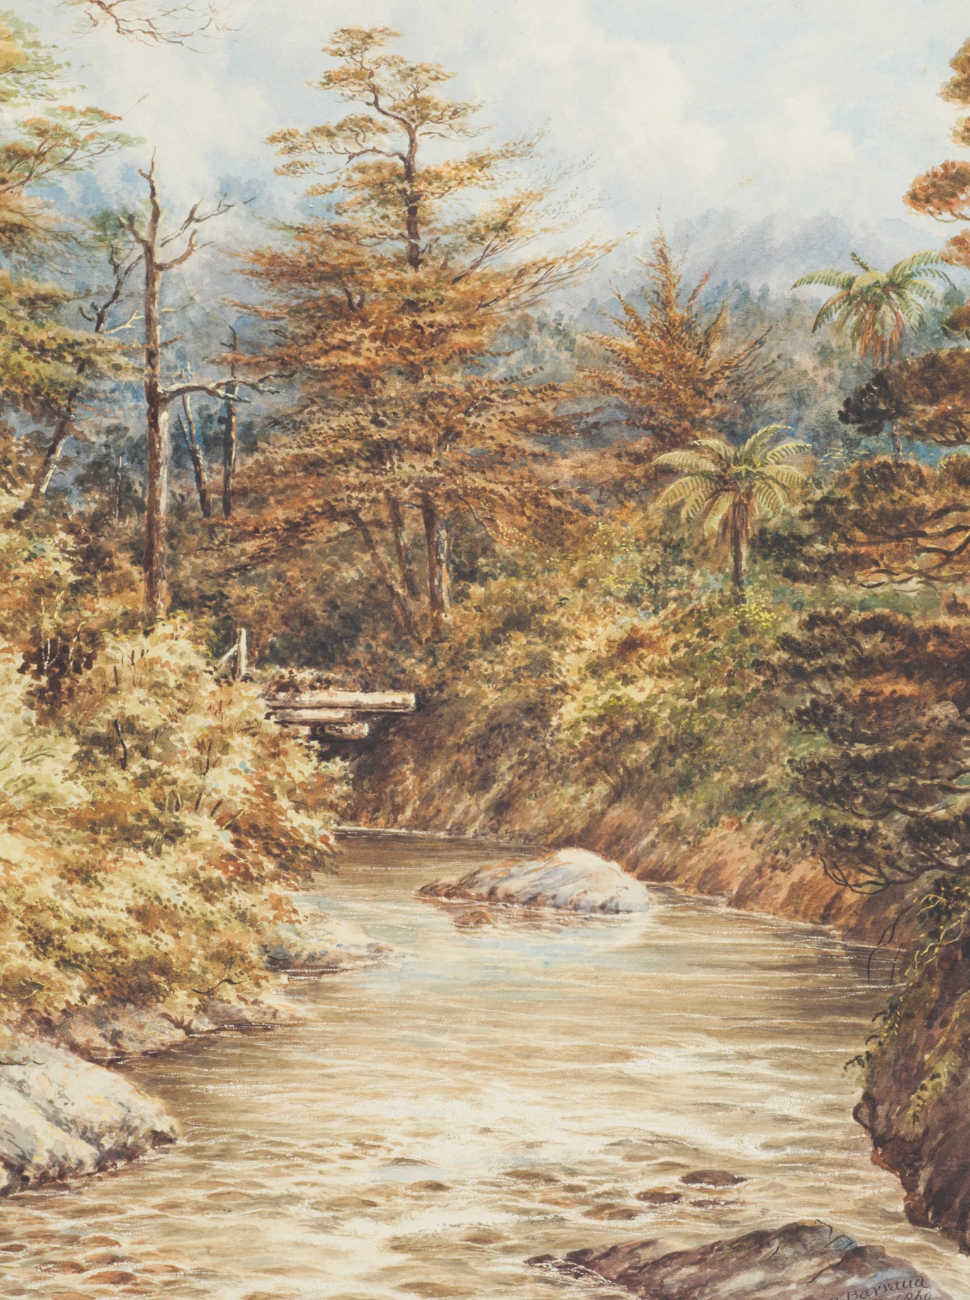
Importance of water for Ngāi Tahu
For Māori, water is the essence of all life, akin to the blood of Papatūānuku (earth mother) who supports all people, plants and wildlife. Māori assert their tribal identity in relation to rivers, and particular waterways have a role in tribal creation stories.
Rivers are valued as a source of mahinga kai, hāngi stones and cultural materials, as access routes and a means of travel, and for their proximity to important wāhi tapu (sacred places), settlements or other historic sites.
Indicators of the health of a river system (such as uncontaminated water, species gathered for food and continuity of flow from mountain source to the sea) can provide a tangible representation of its mauri (life force).
The relationship between Māori, their culture and traditions, ancestral lands, water, sites, wāhi tapu and other taonga (sacred possessions) is a matter of national importance under RMA section 6(e), which decision-makers must recognise and provide for.
Giving effect to the principles of the Treaty of Waitangi is a requirement of the Conservation Act 1987.
FIG 13. collections.tepapa.govt.nz | MA_I161420_TePapa_New-Zealand-river-scene

Slide 17
Water quality impacts the values of Ngāi Tahu
The Awa: freshwater management units
Southland’s four main awa travel from the mountains to the sea, exerting their powerful influence.
WAIAU | APARIMA | ORETI | MATAURA
These awa shape the landscape, provide essential life support, and serve as ara tawhito (traditional travel routes) from the coast to the interior of Te Wai Pounamu.
River valleys gradually widen to form extensive plains, and it is here that many of Southland’s high producing farms are located.
The largest is the Southland Plain – 250,000 hectares surrounding Invercargill to the north, east and west.
North of the Hokonui Hills is the Waimea Plain, and further north again are the plains of Waikaia and Five rivers.
Historical clearance and altered drainage of land for farming and human occupation has since made the area more prone to erosion. The result is greater and faster water runoff and river flood flows, reduced wetlands and riparian habitat, and an increase of contaminants to waterways.
Several estuaries across Southland are in a degraded or threatened state as a result of intensive land use, reclamation of land, contaminants and habitat loss.
Water quality broadly impacts the values of Ngāi Tahu. Changes to, or impacts on, the environment can result in:
» Cultural and spiritual heritage being compromised or lost.
» Increased risk of disease or illness – people and animals.
» Impact on fisheries and aquatic ecosystems, including those downstream.
» Loss of Te Mana o te Wai (the vital importance of water).
» Reduced community wellbeing and connectedness.

Slide 18
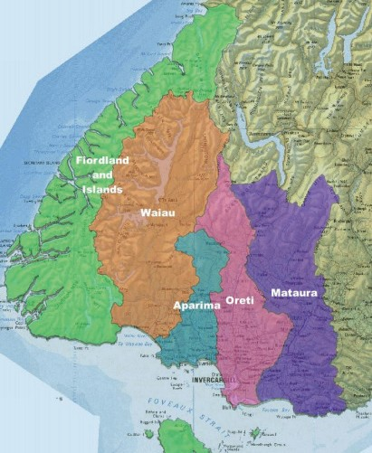
Waituna Lagoon
Waituna Lagoon on the southern coastline of the South Island holds significant cultural and biodiversity importance.
The cultural significance to the local Ngāi Tahu people was recognised under a statutory acknowledgement with the Ngāi Tahu Claims Settlement Act 1998.
Waituna Lagoon is classed as an intermittently closed and open lake and/or lagoon. It is fed by three creeks and drains to the sea through a managed opening.
In the past, the lagoon was mechanically opened to the sea for fish passage and is now opened to manage drainage for surrounding farms.
This area is highly valued for its rich biodiversity, duck shooting, fishing, boating, walking and for its scientific and aesthetic appeal. This includes an impressive ecological habitat diversity, a unique macrophyte community, internationally important birdlife and large areas of relatively unmodified wetland and terrestrial vegetation.
Waituna Lagoon was once surrounded by peat bog wetland, however, through land development in the catchment there has been drainage of wetland areas and clearance of indigenous vegetation
for pasture.
High productivity pastures generate higher nutrient and sediment losses than the original native vegetation.
Waituna lagoon is now experiencing the primary concerns of excessive nutrients and sediment leading to eutrophication.
FIG 14. thrivingsouthland.co.nz | The Freshwater Management Units.

Slide 19
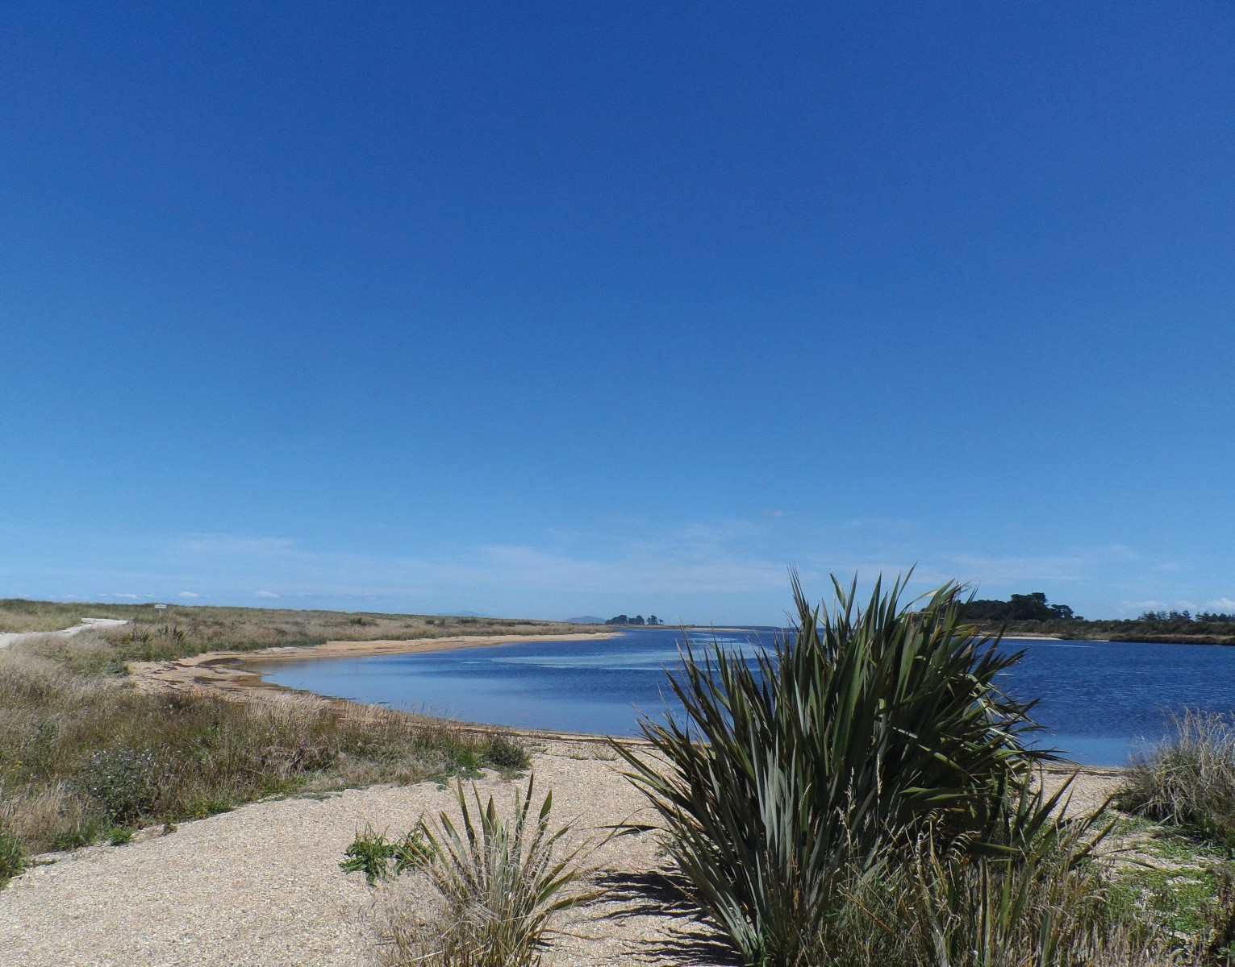
Waiau River
Known as a steep and wild river characterised by whirlpools and the sound of rocks being rolled along the riverbed, Waiau’s name comes from wai (water) and au (rapids/currents).
Waiau Awa was once the swiftest river in New Zealand, and the second largest - so swift that when the famed explorer Tamatea and his Takatimu waka attempted to enter the mouth of the Waiau at Te Waewae Bay, the waka was overturned by three successive waves, becoming the Takatimu mountains. The sails of the Takatimu became the Southland and Waimea plains, with the rivers on either side of them the masts.
The river provided Tamatea and his party, along with earlier Waitaha, an abundance of mahinga kai. Kai was plentiful here (around 200 species of plants and animals), including ti root, aruhe (fernroot), kanakana, inaka (whitebait), flounder, fresh water mussels, tutu and tohemunga on the beach front.
The Waiau guided early Māori into the interior of Te Wai Pounamu through to the West Coast.
The importance of the Waiau was recognised with an acknowledgement in the Ngāi Tahu Settlement Act, 1998.
FIG 15. newzealand.com | Waituna Lagoon

Slide 20
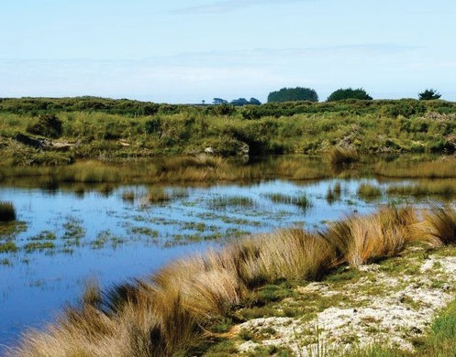
Waiau
In 1969 the Manapōuri Power Scheme was commissioned. Currently around 90 percent of the flow in the catchment is diverted through Manapōuri’s West Arm Power Station.
Waiau River Catchment lies on the eastern edge of Fiordland and is Southlands largest, but least developed, catchment. It contains many lakes, and drains Lake Te Anau into Lake Manapōuri, from where electricity is hydro-generated.
The Waiau and Mararoa rivers are often subject to increased levels of nutrients and sediment leading to eutrophication and algal growths. The invasive alga didymo, first discovered in New Zealand in 2004, is a notable problem in the catchment.
Key contributors to some sites being in lower ecological condition include altered river flow regimes, eroding riverbanks, and modified riparian and wetland habitat.
Elevated levels of nutrients (nitrogen and phosphorus) and sediment are partly attributable to historic and current land uses for human occupation. This could include Manapōuri Power Station.
Of the approximately 767,000 hectares of land in Waiau Catchment, the majority (72 percent) is used for conservation.
There is approximately 185,600ha (24 percent) of land in farming, most of which is dry stock and dairy support.
Commercial forestry makes up approximately 19,400ha (three percent) with the remainder of the land used for activities like residential, commercial use and transport (e.g. road, rail, airstrips).
Approximately 593,100ha is Department of Conservation (DOC) estate and approximately 500ha is Māori freehold land.
FIG 16. southlandnz.com | Waituna Lagoon and surrounding wetlands

Slide 21
Mataura River
Mataura River is linked with an ancestor of the great Arawa waka (one of the great voyaging canoes), which gives the river immense spiritual significance to Waitaha, Kāto Māmoe and Ngāi Tahu.
The Mataura Falls was an important site for mahinga kai associated with the kanakana (lamprey) which attach themselves to the falls. The importance of the Mataura for kai and other taonga has been recognised by the statutory acknowledgement in the Ngāi Tahu settlement.
The Mataura is also renowned as a source of brown trout.
Mataura River Catchment is the region’s second largest, rising in the Eyre Mountains and running to Toetoes (Fortrose) Estuary.
Much of this catchment has been developed for agriculture, which is particularly intensive in the middle and lower reaches. Flood plains have contributed both to agricultural productivity and social turmoil.
Pressures exist in the middle reaches near Riversdale with the advent of pasture irrigation to support intensifying land use activities in the district.
Existing land use activities, increasing agricultural intensification and expansion of pasture irrigation are key contributors to water quality and quantity of water resources in Mataura Catchment.
The volume of water allocated for consumptive use in the Mataura Catchment has increased significantly over the past 10 years from approximately 100,000m³ /day in 2000 to around 300,000m³ /day in late 2010.
The Mataura is one of the most nutrient-enriched rivers, due to it being in lowland areas and surrounded by predominantly pastoral farmland.
Ambient bacterial loadings are low in the upper Mataura but increase in the middle and lower reaches. However, the Waikaia River often has high bacterial levels exceeding Ministry for the Environment guidelines even in low flows. Water clarity decreases markedly between the upper and lower reaches of the Mataura.
The Mataura River is an example of a major New Zealand waterway in which water quality has improved since point-source discharges of organic waste were reduced and/or received improved treatment before discharge.
While the Mataura River still has elevated nutrient and bacteria levels from non-point-sources, marked improvements in the appearance of the river (less
surface scum and foam) have been attributed to the reduction in organic matter entering it.
In 1975, 15.5 tonnes of organic waste were discharged into the river each day. By 2000, because of improvements to effluent treatment at large meatworks alongside the river, the organic waste discharged had decreased to just over 3 tonnes a day.

Slide 22
Oreti River
Oreti Awa traverses a significant area of Murihiku, stretching from its mouth at the New River Estuary up to almost the edge of Lake Wakatipu.
Oreti means place of the snare and the river’s name came from Oreti Beach, Te Whanga Koreti Hau Tonga - the Bay that catches the South Wind.
The Oreti was one of the main trails inland, an important guide to the pounamu pathways; in fact, pounamu can be found in the upper reaches of the river itself.
Abundant kai in the Oreti supported numerous parties which ventured into the interior of Te Wai Pounamu and would return via mōkihi (raupō/reed rafts) with cargo of mahinga kai and pounamu. Mahinga kai included water fowls, eels and inaka.
A number of settlements were located at the mouth of the Oreti, including Oue and Omaui, along with urupā (resting places) for Ngāi Tahu tupuna (ancestors).
The Oreti is Southland’s third largest catchment. It runs from the Thomson Mountains in the north of the region to the New River Estuary adjacent to Invercargill.
The upper catchment maintains many of its natural qualities and is renowned for its trophy brown trout fishing. The mid and lower reaches of the Oreti Catchment have been substantially modified for drainage, flood control and channel clearance work.
Oreti River tributaries, such as the Winton and Waikiwi streams and the Makarewa River, are each subject to point-source discharges of effluent from industry and municipal sewage treatment.
Potential impact to water quality may also arise through tile drain and non-point source discharges.
Of the nearly 400,000 hectares of land in the Oreti and Invercargill catchments, approximately 71 percent (280,300ha) is now used
for farming.
The land use is a mix of:
» Sheep and beef (approximately 45 percent of the farming area).
» Dairy and dairy support (38 percent), mixed livestock and livestock support (15 percent), deer (1.7 percent)
» Arable farming and horticulture (less than 0.3 percent)
» Approximately 20,300ha (5 percent) of the catchment area is in commercial forestry.

Slide 23
Aparima River
Aparima is the smallest of Southland’s four main catchments. It rises from the Takitimu Mountains west of Mossburn and flows into Jacobs River Estuary at Riverton.
Aparima Awa and its estuary were valuable sources of mahinga kai, including shellfish, tuaki (cockle), pātiki (flounder), kūtai (mussels), tuna (eels) and inaka.
An eel weir was constructed where Pourakino River meets the Aparima.
There was a permanent settlement at the mouth of the Aparima, with urupā nearby. The mouth of the Aparima was tauranga waka, a place where sea voyages were launched.
Aparima Awa was also an ara tawhito, an integral part of the trail networks in and around Te Wai Pounamu. The knowledge of the route and mahinga kai available ensured safe passage for those who made the journey.
Aparima was briefly known as Jacobs River following European settlement, after Old Jacob, an elderly Māori man.
The headwaters drain alpine, native tussock and forested land. For the most part the river flows through farmland on the Southland Plains, with clear pools on a gravelly bed.
Due to its terrain and the high rainfall, winter management is a particular issue for the catchment.
The Aparima is popular with fishermen as the wide estuary affords shelter for a small fishing fleet and is the scene of boating and swimming activities in summer.
The rolling hill country in its middle reaches is more agriculturally developed, and much of the lower catchment has been extensively modified over the past century, with the drainage of wetlands and the straightening and shortening of streams to assist in flood management.
The main pressures on water quality in the Aparima Catchment are due to dairy farm intensification as drain networks in the lower catchment can discharge water to receiving streams.
The amount of dairying in the catchment is around 23 percent, with 35 percent being sheep and beef farms and 11 percent in pine or exotic forests. The balance is made up of eight percent indigenous forests, 17 percent DOC land as well as QE2 Trust land, wetlands and roading, with minimal cropping.
Aparima Catchment covers 207,000ha, with 81 percent developed. There are also large areas of public conservation land as well as beech forest.

Slide 24
Kā Huru Manu – Ngāi Tahu – a point of reference
Other sources of information on Ngāi Tahu
Tangata Whenua: An Illustrated History
bwb.co.nz/books/tangata-whenua-illustrated-history
The story of Ngāi Tahu
teara.govt.nz/en/Ngāi-tahu
Te Tangi a Tauira es.govt.nz/repository/libraries/id:26gi9ayo517q9stt81sd/hierarchy/about-us/ plans-and-strategies/regional-plans/iwi-management-plan/documents/Te%20 Tangi%20a%20Tauira%20-%20The%20Cry%20of%20the%20People.pdf
Collection of historical research material:
Ngāi Tahu Books
Ngāitahu.maori.nz/books
Kōparapara: Introduction to Māori World
aucklanduniversitypress.co.nz/te-koparapara-an-introduction-to-the-maori- world
University of Canterbury Ngāi Tahu Research Centre
canterbury.ac.nz/ntrc/publications
Kā Huru Manu is a project administered by the Ngāi Tahu Archive Team alongside the 18 Ngāi Tahu Papatipu Rūnaka, and is under the guidance of Te Pae Kōrako. Established in 2012, Te Pae Kōrako is responsible for the overview and development of the Ngāi Tahu Archive.
The Ngāi Tahu Cultural Mapping Project is dedicated to gathering and producing tribal resources for Te Wai Pounamu by critically mapping the cultural values that are important for Ngāi Tahu. Names of places hold much value for Ngāi Tahu, as names of sites and environmental landmarks such as mountains, lakes, rivers, and cultural sites carry heritage and history.
This virtual atlas covers over 5,000 place names that are fully referenced from whānau manuscripts, published books, 19th century maps, newspaper articles and a vast array of unpublished material.
The project helps strengthen Ngāi Tahu’s relationship with the landscape of Te Wai Pounamu, by ensuring traditional Māori place names and associated stories within the rohe (tribal area) are carried on, conserving the historical heritage.
With the cultural mapping, Kā Huru Manu also covers in great detail the whakapapa (genealogy) of Ngāi Tahu and Te Kerēme, the Ngāi Tahu Claim which is found on their website kahurumanu.co.nz/atlas
Please note that Kā Huru Manu is not a repository of all Ngāi Tahu histories, place names or sites of significance.

Slide 25
References
These references were used throughout the creation of this document.
Environment Southland Regional Council. (2014). Land Use Change in The Southland Region: Land Use Change – Indigenous Vegetation.
doc.govt.nz/parks-and-recreation/things-to-do/hunting/where-to-hunt/fiord- land/fiordland-hunting/where-to-hunt/waitutu-forest/
nzgeo.com/stories/a-walk-in-the-waitutu-forest/
Te Rūnanga o Ngāi Tahu. (1997). Te Whakataunga Celebrating Te Kerēme - the Ngāi Tahu Claim: Who we are. Ngāitahu.iwi.nz/Ngāi-tahu/who-we-are/
Ngāi Tahu Farming. (n.d). Tangata. Ngāitahufarming.co.nz/people Bill Dacker, Murihiku – The Southland Story Published 2006, p.45
David Grant, ‘Southland region - Early settlement’, Te Ara - the Encyclopedia of New Zealand. TeAra.govt.nz/en/southland-region/page-5
Jock Phillips, ‘Sealing - The rise and fall of sealing’, Te Ara - the Encyclopedia of New Zealand. TeAra.govt.nz/en/sealing/page-1
J.M.R. Owens. The Oxford History of NZ, 2nd Edition ed. Geoffrey Rice, p.31
Tom Brooking, Milestones: Turning Points in New Zealand History, 2nd Edition, p.38
Bluff History Group. (2007). Seal hunters of the South. Bluff History Group.
Nancy Swarbrick, ‘Flax and flax working - The early flax trade’, Te Ara - the Encyclopedia of New Zealand. TeAra.govt.nz/en/flax-and-flax-working/page-3
John Hall Jones, Murihiku: The Southland Story, published 2006, p.60 and teara.govt.nz/en/whaling/page-2
Bill Dacker, Murihiku: The Southland Story, published 2006, p.50
M.R. Owens, The Oxford History of NZ, 2nd Edition ed. Geoffrey Rice. p.33 Margaret Trotter, Murihiku: The Southland Story, published 2006, p.193
Te Rūnanga o Ngāi Tahu. (1997). Te Whakataunga Celebrating Te
Kerēme - the Ngāi Tahu Claim, Introduction. Ngāitahu.iwi.nz/Ngāi-tahu/te- whakataunga-celebrating-te-kereme-the-Ngāi-tahu-claim/
Te Rūnanga o Ngāi Tahu. (1997). The Settlement: Claim History. Ngāitahu.iwi. nz/Ngāi-tahu/the-settlement/claim-history/
Wynyard, Matthew. 2019. “‘Not One More Bloody Acre’: Land Restitution and the Treaty of Waitangi Settlement Process in Aotearoa New Zealand” Land 8, no. 11: 162. doi.org/10.3390/land8110162
Environment Southland Regional Council. (2021). The Problem with our Water. waterandland.es.govt.nz/about/the-problem-with-our-water
Roger G. Kellaway. (1970). The Changing Agricultural Geography of Southland 1878 – 1940. ir.canterbury.ac.nz/bitstream/handle/10092/14416/ Kellaway_1970_thesis.pdf?sequence=1
Erik Olssen, Murihiku: The Southland Story, published 2006, p.75 & Cathy Macfie, Murihiku: The Southland Story, p.172.
discover.stqry.com/v/takitimu-heritage-trails/38962fa89e25 5a3ffe3b45958e0eb7ad); discover.stqry.com/v/Round-Hill/ s/00f5ceb4ab21de1421f1d2128830b73c); nzhistory.govt.nz/keyword/waikaka
John Cutt, Murihiku: The Southland Story, published 2006, p.152; Cathy Macfie, Murihiku: The Southland Story, published 2006, p.169. paperspast. natlibgovt.nz/newspapers/ST18820120.2.10?end_date=31-12-1882&items_ per_page=10&phrase=2&query=Edendale+Dairy+ Factory&snippet=true&sort_by=byDA&start_date=01-01-1881&title=ME%2cST
paperspast.natlib.govt.nz/newspapersST18830307.2.7?end_date=31-12- 1883&items_per_page=10&page=6&query=opawa&snippet=true&sort_ by=byDA&start_date=01-01-1883&title=ST https://paperspast.natlib.govt. nz/newspapers/ST18830530.2.3.3?end_date=31-12-1883&items_per_ page=10&page=18&query=opawa&snippet=true&sort_by=byDA&start_ date=01-01-1883&title=ST
Tom Brooking, Milestones: Turning Points in New Zealand History, 2nd ed, p.93
Robertson, Hugh A. (2019). Loss of wetlands since 1990 in Southland, New Zealand. New Zealand Journal of Ecology, 43(1).
Wynyard, Matthew. 2019. “‘Not One More Bloody Acre’: Land Restitution and the Treaty of Waitangi Settlement Process in Aotearoa New Zealand” Land 8, no. 11: 162. doi.org/10.3390/land8110162
Te Rūnanga o Ngāi Tahu. (1997). The Settlement: Claim History. Ngāitahu.iwi. nz/Ngāi-tahu/the-settlement/claim-history/
Roger G. Kellaway. (1970). The Changing Agricultural Geography of Southland 1878 – 1940. ir.canterbury.ac.nz/bitstream/handle/10092/14416/ Kellaway_1970_thesis.pdf?sequence=1
Southland Progress League. (1978). A survey of Southland, New Zealand. (Rev. ed..). Southland Progress League.
stats.govt.nz/indicators/livestock-numbers
Environment Southland Regional Council. (2021). The Problem with our Water. waterandland.es.govt.nz/about/the-problem-with-our-water
Robertson, Hugh A. (2019). Loss of wetlands since 1990 in Southland, New Zealand. New Zealand Journal of Ecology, 43¹.
Te Whakataunga - Celebrating the Claim - Te Rūnanga o Ngāi Tahu. Ngāitahu.iwi.nz
Ledgard G. (2013). Land Use Change in the Southland Region. Environment Southland. es.govt.nz/repository/libraries/ id:26gi9ayo517q9stt81sd/hierarchy/environment/science/science- summary-reports/land_use_change_in_the_southland_region.pdf
The problem with our water - Environment Southland Water and Land. es.govt.nz
dairynz.co.nz/media/5794073/nz-dairy-statistics-2019-20-dnz.pdf rnz.co.nz/news/rural/2374/southland-grain-growers-beat-own-world-record
Opinion: What the regenerative farming debate needs now - NZ Herald; Dr Jacqueline Rowarth: Regenerative agriculture - context is everything - NZ Herald
Te Runanga O Ngāi Tahu (undated) “Freshwater Policy” available on Ngāitahu.iwi.nz
doc.govt.nz/about-us/statutory-and-advisory-bodies/nz-conservation- authority/publications/protecting-new-zealands-rivers/02-state-of-our- rivers/maori-values/#:~:text=For%20M%C4%81ori%2C%20water%20is%20 the,role%20in%20tribal%20creation%20stories.
David Grant, ‘Southland region - Farming: 1950s to present day’, Te Ara - the Encyclopedia of New Zealand, TeAra.govt.nz/en/southland-region/page-8
R.M. Monaghan, R.J. Wilcock, L.C. Smith, B. Tikkisetty, B.S. Thorrold, D. Costall. (2007). Linkages between land management activities and water quality in an intensively farmed catchment in southern New Zealand. Agriculture, Ecosystems & Environment. Volume 118, Issues 1–4, pages 211- 222. doi.org/10.1016/j.agee.2006.05.016.
Environment Southland Regional Council. (2021). Essential Freshwater Package, Estuaries. www.es.govt.nz/environment/water/essential-freshwater- package
Zeldis. J, Measures. R , Stevens. L , Matheson. F , Dudley. B. (2019). Remediation options for Southland Estuaries. NIWA. contentapi.datacomsphere.com.au/v1/h%3Aes/repository/libraries/
id:26gi9ayo517q9stt81sd/hierarchy/document-library/reports/science-reports/ Remediation%20Options%20for%20Southland%20Estuaries%202019.pdf
LAWA Land, Air, Water, Aotearoa. (2019). Waituna Lagoon. Environment Southland Regional Council. lawa.org.nz/explore-data/southland-region/ lakes/waituna-lagoon/
Rekker, J. Wilson, S. (2016). Waituna Catchment Water Quality Review. waituna. org.nz/repository libraries/id:1ytnyjmap17q9s20wg7s/hierarchy/Waituna%20 resources/Catchment%20management
/2016%2005%20Rekker%20Waituna%20Catchment%20Water%20Quality%20 Review.pdf
kahurumanu.co.nz/atlas Waiau River Care Group,
legislation.govt.nz/act/public/1998/0097/latest/DLM431302.html
LAWA Land, Air, Water, Aotearoa. (2019). Waiau. Environment Southland Regional Council. lawa.org.nz/explore-data/southland-region/ lakes/waituna-lagoon/waterandland.es.govt.nz/repository/libraries/ id:1tkqd22dp17q9stkk8gh/hierarchy/PWL%20documents/Regional%20 Forum%20documents/Workshop%20three%20-%20Te%20Anau/2%20 Waiau%20Values%20Snapshot_Final.pdf
Water and Land. (2019). Waiau Catchment Values. waterandland.es.govt.nz/ repository/libraries/id:1tkqd22dp17q9stkk8gh/hierarchy/PWL%20documents/ Regional%20Forum%20documents/Workshop%20three%20-%20Te%20 Anau/2%20Waiau%20Values%20Snapshot_Final.pdf
Water and Land. (2019). Waiau Catchment Values. waterandland.es.govt.nz/ repository/libraries/id:1tkqd22dp17q9stkk8gh/hierarchy/PWL%20documents/ Regional%20Forum%20documents/Workshop%20three%20-%20Te%20 Anau/2%20Waiau%20Values%20Snapshot_Final.pdf
Bill Dackers. legislation.govt.nz/act/public/1998/0097/latest/DLM430875.html
LAWA Land, Air, Water, Aotearoa. (2019). Mataura. Environment Southland Regional Council. www.lawa.org.nz/explore-data/southland-region/lakes/ waituna-lagoon/

Slide 26
References cont.
Hughes, B., Harris, S., & Brown, P. (2011). Mataura Catchment Strategic Water Study. Environment Southland. es.govt.nz/repository/libraries/id:26gi9ayo517q9stt81sd/hierarchy/about-us/plans-and- strategies/strategies/mataura-catchment-strategic-water-study/documents/mataura_catchment_strategic_ water_study2.pdf
LAWA Land, Air, Water, Aotearoa. (2019). Mataura. Environment Southland Regional Council. lawa.org.nz/ explore-data/southland-region/lakes/waituna-lagoon/
Ministry for the Environment. (2007). Environment New Zealand 2007, Chapter 10: Freshwater. mfe.govt.nz/ publications/environmental-reporting/environment-new-zealand-2007-chapter-10-freshwater/current
legislation.govt.nz/act/public/1998/0097/1.0/DLM430883.html nzhistory.govt.nz/culture/maori-language-week/1000-maori-place-names Lloyd Esler.
LAWA Land, Air, Water, Aotearoa. (2019). Oreti. Environment Southland Regional Council. lawa.org.nz/ explore-data/southland-region/lakes/waituna-lagoon/
Environment Southland Regional Council. (2021). Essential Freshwater Package, Estuaries. es.govt.nz/ environment/water/estuaries/estuaries-in-the-oreti
Atlas — Cultural Mapping Project — Te Rūnanga o Ngāi Tahu. kahurumanu.co.nz legislation.govt.nz/act/public/1998/0097/10.0/DLM430848.html
Muir, K. ( 5 December 2018). Aparima Catchment Improves. Otago Daily Times. odt.co.nz/rural-life/rural-life- other/aparima-catchment-improves
LAWA Land, Air, Water, Aotearoa. (2019). Aparima. Environment Southland Regional Council. lawa.org.nz/ explore-data/southland-region/lakes/waituna-lagoon/
Kā Huru Manu Ngāi Tahu.(n.d). Cultural Mapping Story. www.kahurumanu.co.nz/about-us

