Slide 1
Getting the Best out of Biologicals
Innovative new biostimulants and biofertilisers for crop and pasture establishment and growth
Alison Stewart
CEO FAR

Slide 2

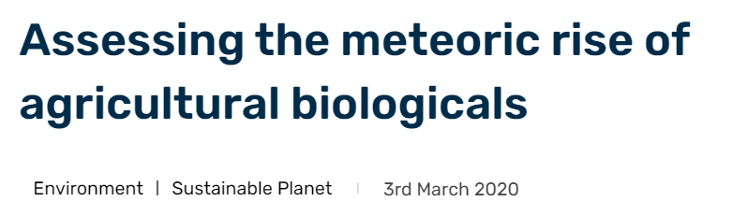
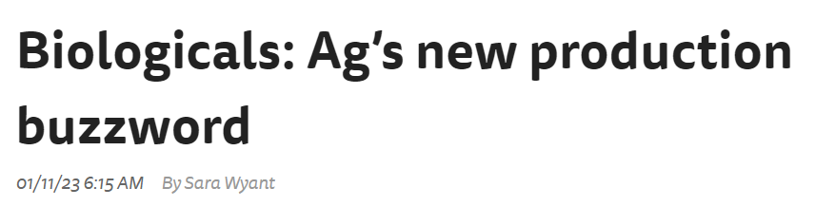



Slide 3
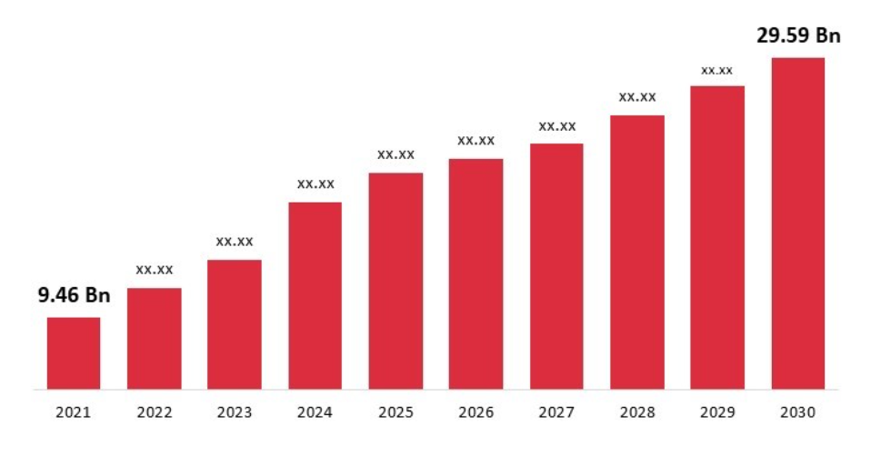
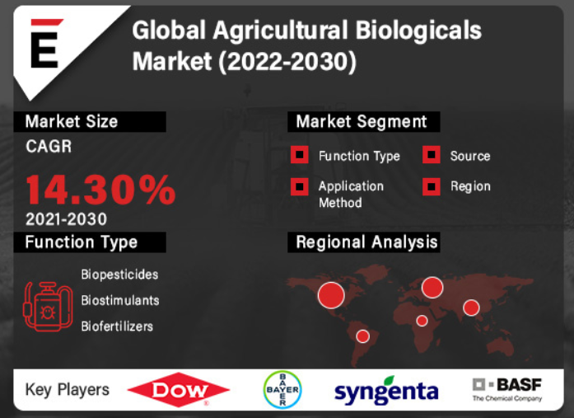
Global Biologicals Market

Slide 4
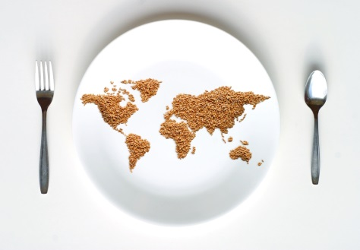
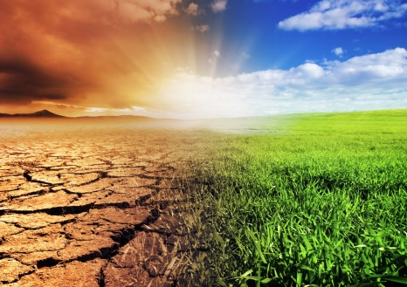
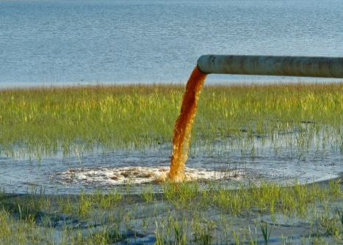
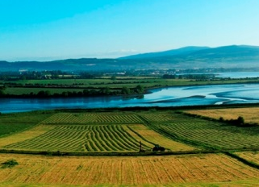
Key Drivers for Bio-Based Products
Global Food Security
Growing more from less
Climate Change
Temperature, moisture, salinity extremes
Environmental Pollution
Residues / leachates
Sustainability
Ecosystem services
Notes:
Key drivers – global food security – growing more from less
World population expected to reach >8billion by 2030 and >9 billion by 2050. Growing need for food. Arable acreage is only expected to grow moderately. So feeding this growing population will require yield increases and enhanced crop quality
Climate change – extremes of temp/moisture/salinity. Going to require more resilient crops. Biologicals can increase plant tolerance to and recovery from abiotic stress
Environmental pollution – pesticide residues in soil, bitrate leachates into waterways. Biologicals can facilitate nutrient assimilation, translocation and use – can keep nutrients from leaching into the groundwater
Sustainability – recognition of the value of ecosystem services. Farmers recognize the need for sustainability. Starting to understand that they have to manage their farms as whole ecosystems

Slide 5
Confusing Categories
Biocontrol Agents
Soil Conditioners
Bio-inoculants
Plant Growth Promoters
Biopesticides
Biofertilizers
PGPR’s
Biodigesters
Biologicals
Stress Protectors
Biostimulants

Slide 6
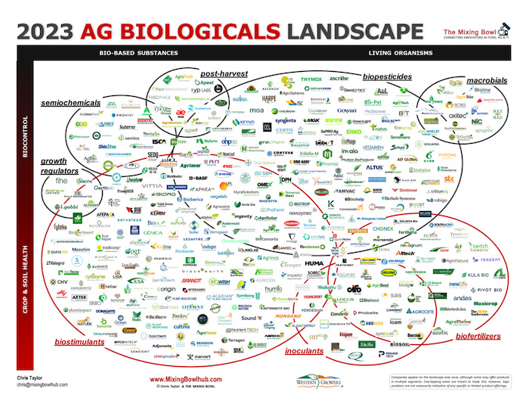

Slide 7
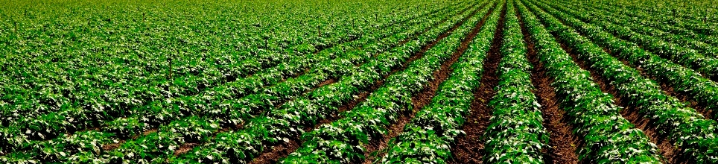
Definitions
Biopesticides
Crop Protection
Biostimulants
Crop Enhancement
Biofertilizers
Crop Nutrition
Notes:
Simplify down to three main categories
Biopesticides that target the control of pests (crop protection)
Biostimulants that focus on enhancing the health of the plant – can enhance yield and stress tolerance but don’t provide nutritional supplement
Definition – natural products/microbes that enhance nutrient uptake, nutrient efficiency, tolerance to abiotic stress and crop quality but have no direct activity against pests
Biofertilizers that provide a nutritional benefit

Slide 8
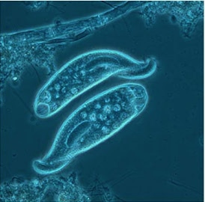
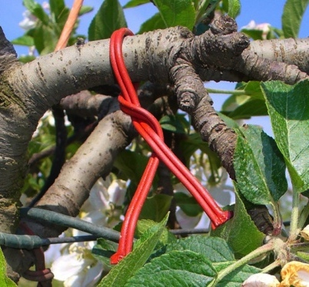

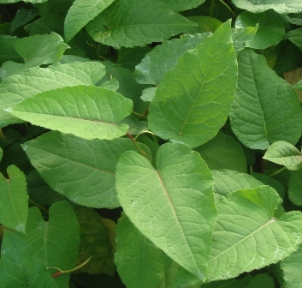
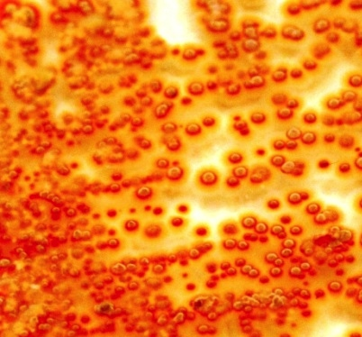

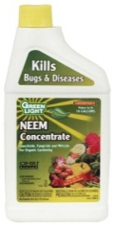

What are Biopesticides?
Microbials
Biochemicals
Fungi, Bacteria, Viruses, and Protozoa
Plant Extracts, Pheromones, Soaps, and Fatty Acids
75-year history of safe use
Most are used in conventional agriculture although they can be used in organic production

Slide 9
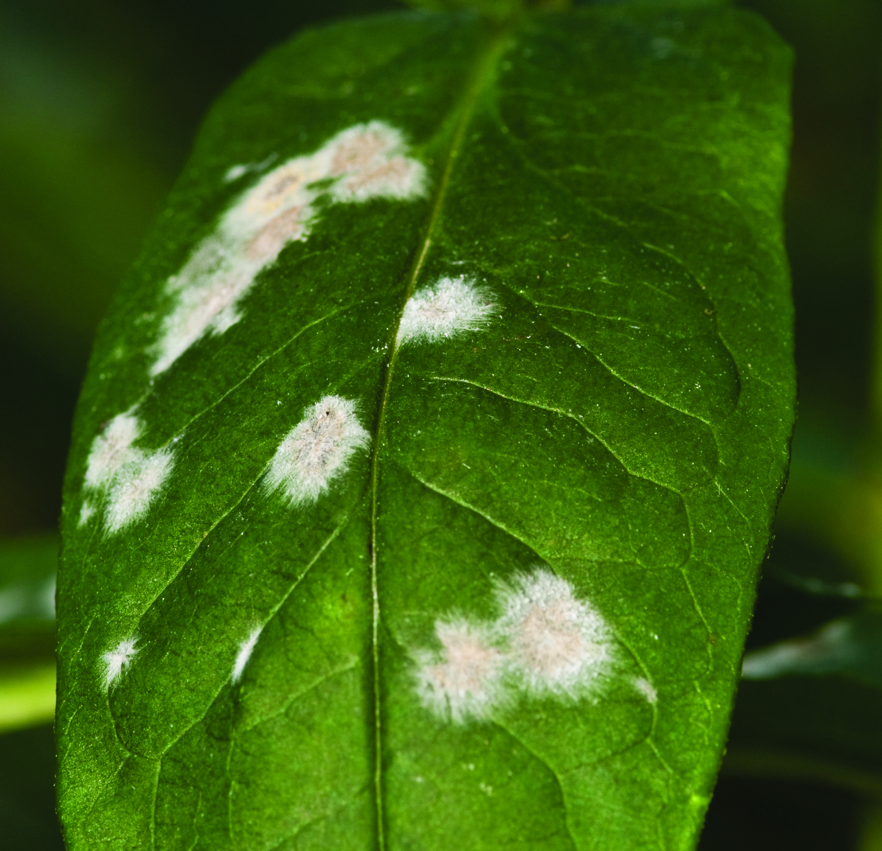
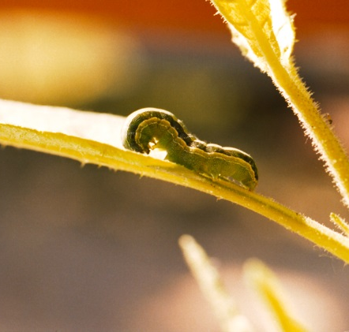
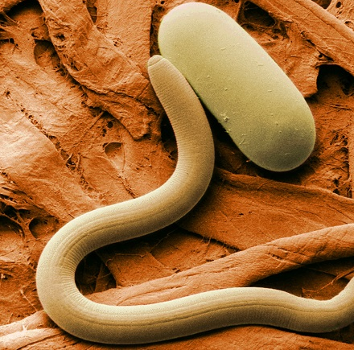
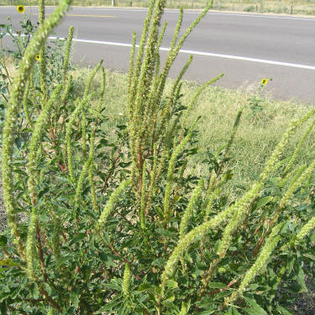
Crop Protection—Biopesticides
Biofungicides
Bioinsecticides
Bionematicides
Bioherbicides
Notes:
Look at examples of the first main category – Biopesticides
Divided up into four main categories depending on the pest target
Fungicides
Insecticides
Nematicides
Herbicides

Slide 10
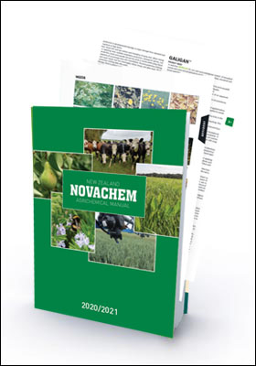
NZ Biopesticide Regulations
Pesticidal products - Approved
Hazardous Substances and New Organisms (HSNO)
Agricultural and Veterinary Medicines (ACVM)

Slide 11
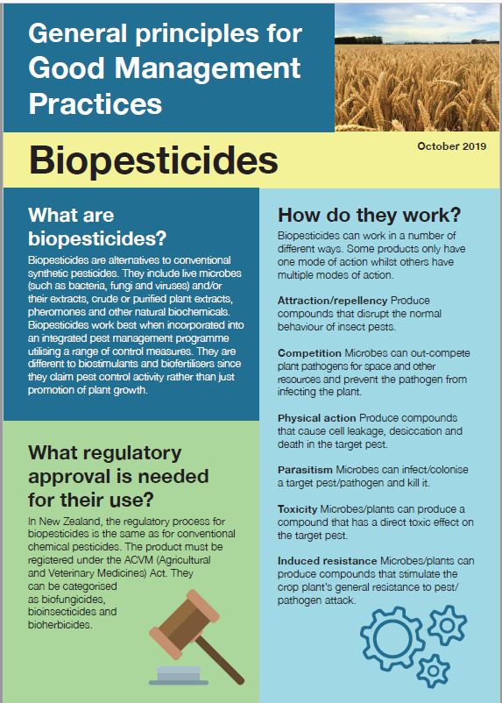
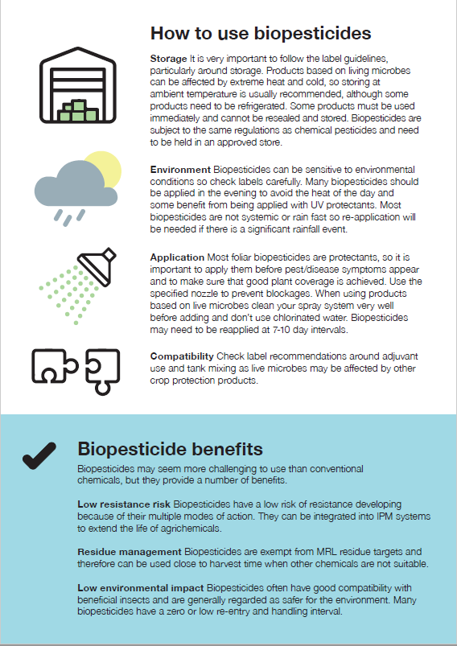
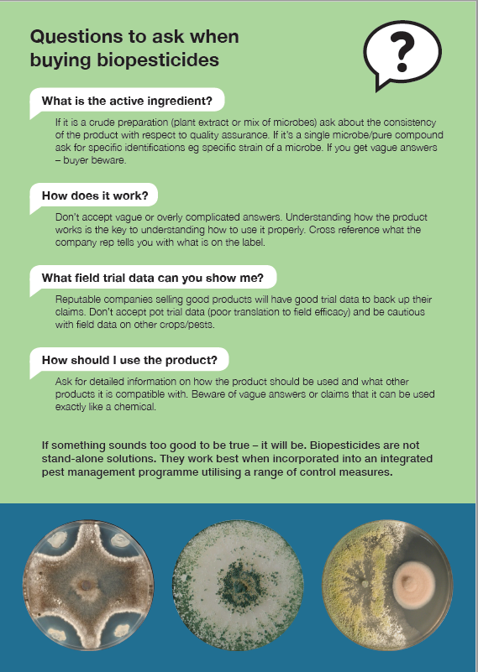
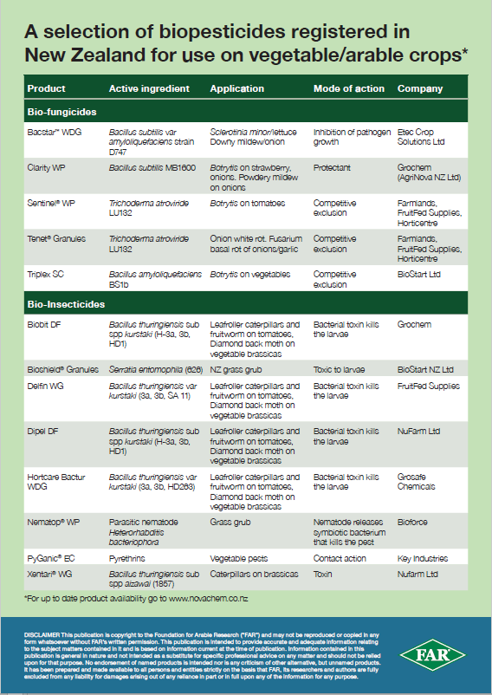
alison.stewart@far.org.nz

Slide 12
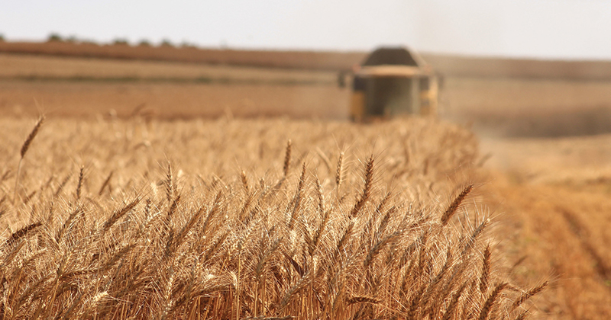
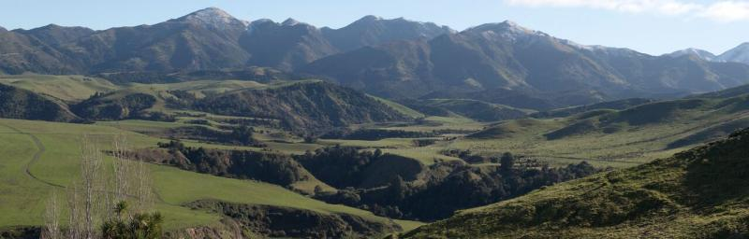
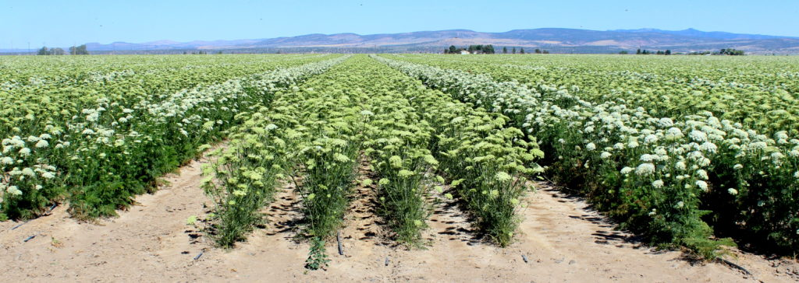



AGR96X for Grass Grub Control

Slide 13
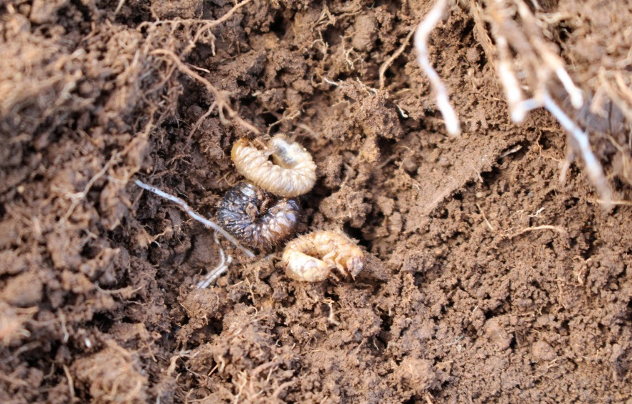
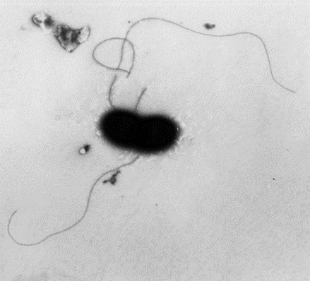
AGR96X for Grass Grub and Manuka Beetle control
Grass grub causes major losses to NZ agriculture and horticulture
Many synthetic pesticides are being deregistered/under review.
Diazinon (July 2028).
Serratia proteamaculans strain AGR96X
- Applied as granule
- Effective against grass grub and manuka beetle
- Rapid kill 5 to 12 days of ingestion.
- Efficacy demonstrated in -pot and >20 field trials, diverse geographies (Southland to Taupo) covering pasture, ryegrass/clover, carrot, wheat and oats
- Similar efficacy to organophosphates and neonicotinoids
- No negative effects on non target animal /plants
- Safety, production, efficacy data collated -about to be submitted to ACVM
AGR96X infected grubs
AGR96X

Slide 14
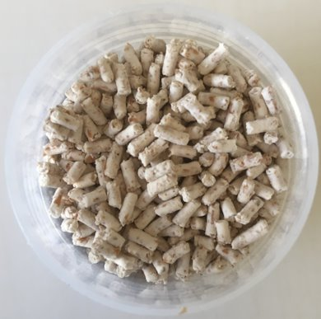

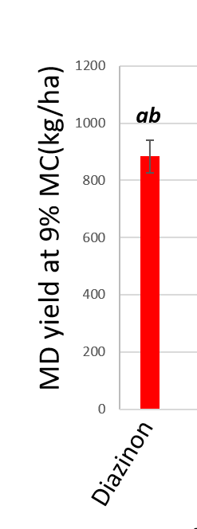
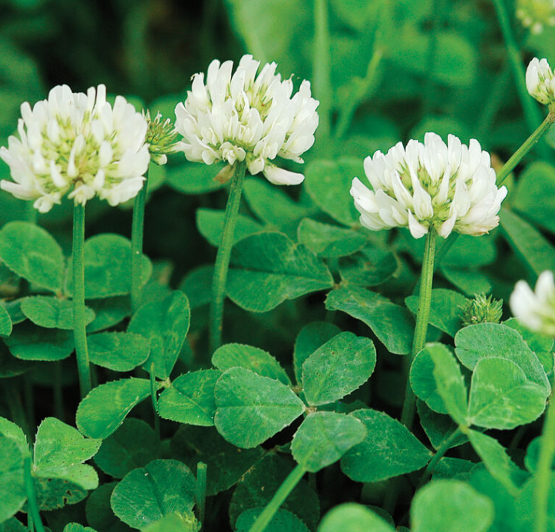

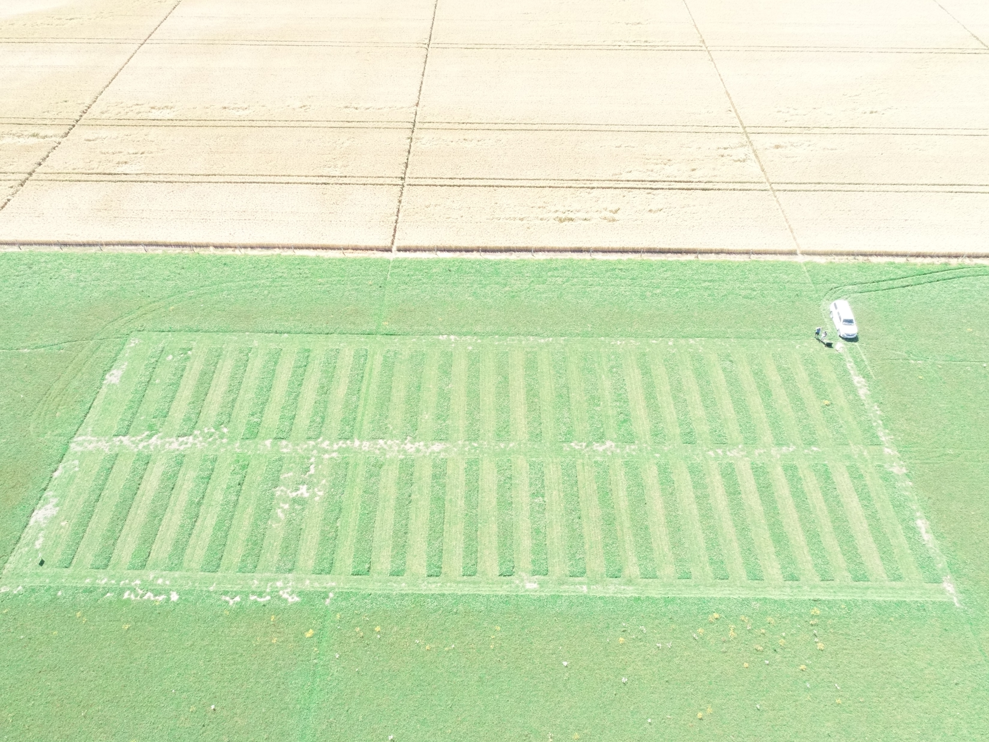
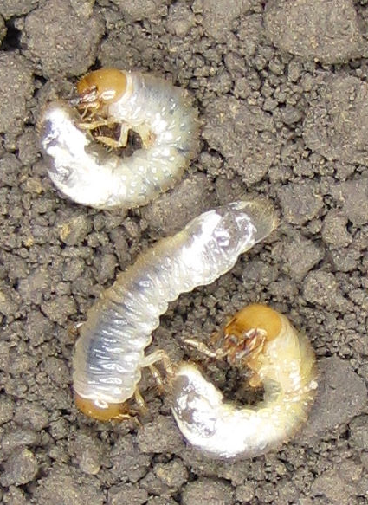
AGR96X: clover seed crops
granule
Dressed clover seed yield
1000
800
600
400
200
0
MD yield (kg/ha)
AGR96X
Untreated
Diazinon 5 kg/ha
AGR96X 15kg/ha
AGR96X 20kg/ha
AGR96X 30kg/ha
AGR96X 10⁹ 30kg/ha
AGR96X 10⁷ 10kg/ha
AGR96X 10⁷ 20kg/ha
Suscon green 7.5 kg/ha
Notes:
Field trial Canterbury Clover seed crop AGR96X afforded similar control as Diazinon/Suscon green

Slide 15
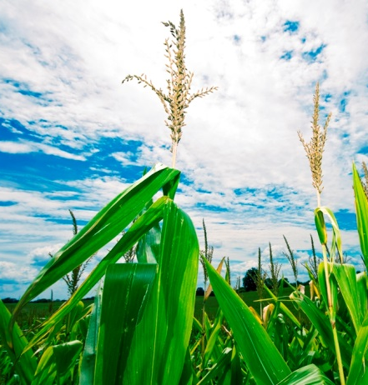
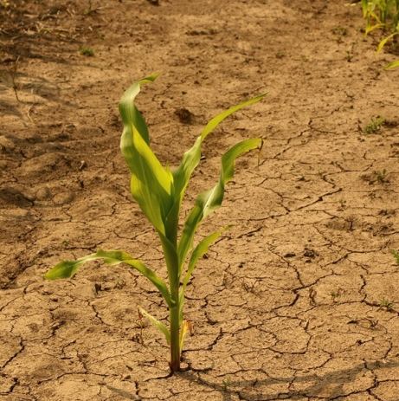
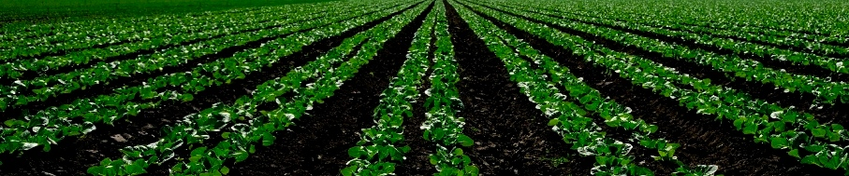
Biostimulants/Biofertilisers
Nutrition
Temperature Tolerance
Plant Growth Promotion
Stress Tolerance
Drought
Tolerance
Notes:
Next category of biologicals – Biostimulants (focus on providing plant health benefits excluding nutritional)

Slide 16
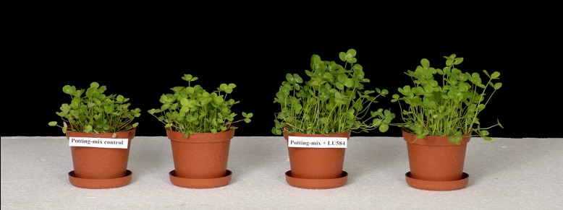
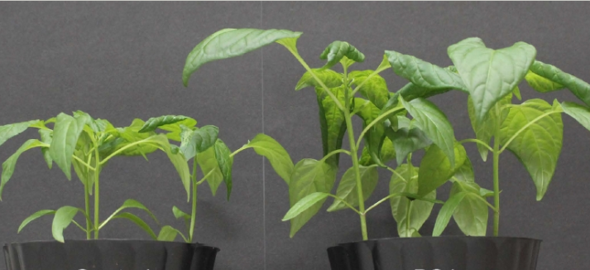
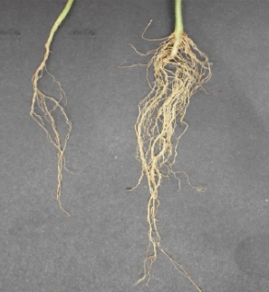
Growth Promotion
Fish oil/extracts
Plant extracts
  Seaweed
  Tea tree
  Reynoutria
Microbes
  Trichoderma
  Pseudomonas
  Bacillus
  Streptomyces

Slide 17
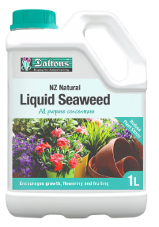

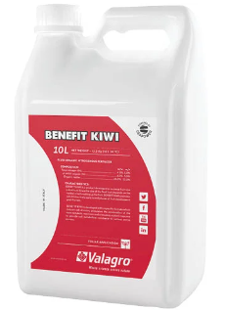

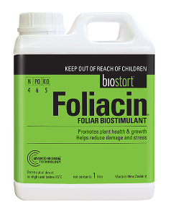
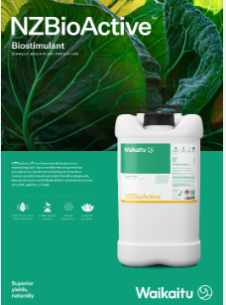
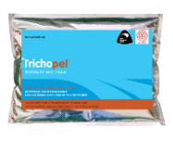
Credible company
Active ingredient/s
Mode of Action
Field Performance data
Technical support

Slide 18
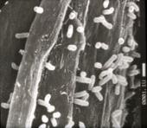
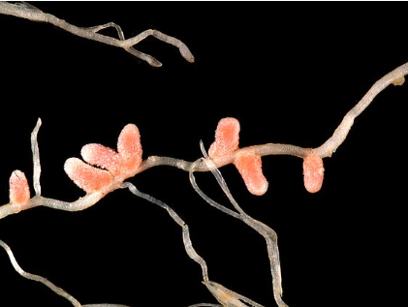
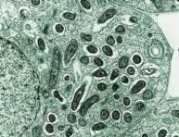
Nitrogen Fixation
Some soil microbes can covert atmospheric N to ammonia (via nitrogenase enzyme complex)
Rhizobium – legume symbiosis (peas, soybean, clover)
Root nodules – fix nitrogen
Mutually beneficial relationship

Slide 19
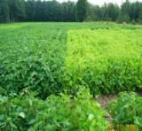
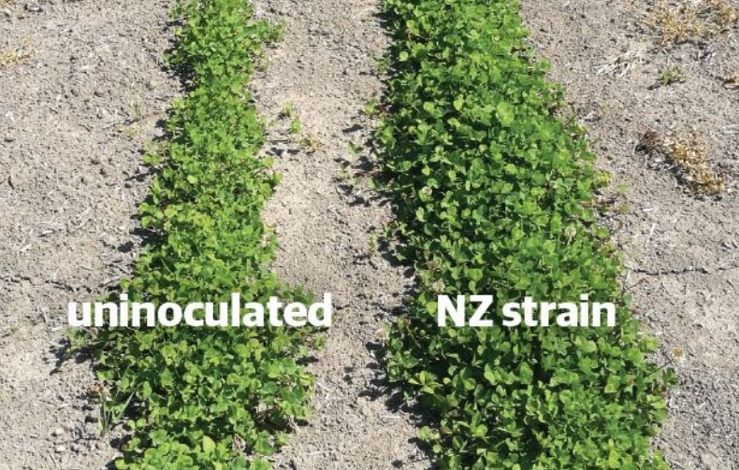
Nitrogen Fixation
NZ – 1950-60’s
Clover/lucerne seed inoculated with Rhizobium leguminosarum. (Australian strains)
Now widespread in NZ pastoral soils
Yield increases of up to 30%
Increase N fixation by 40-80kg N/ha
Selection for improved Rhizobium spp.
Commercial rhizobial inoculants

Slide 20



Nitrogen Fixation
Asymbiotic N-fixing bacteria
Colonize the soil and the root surface
Azotobacter
Azospirillum
Bacillus
Not endophytic
Less efficient at providing plants with N source

